Slide 1

TRAIN.03 HEAVY VEHICLE DRIVER FATIGUE
AND WORK DIARY INDUCTION

Slide 2
FATIGUE POLICY
5'S Australia Pty Ltd recognises that Fatigue is a symptom, rather than a specific disease or disorder.
People who are fatigued feel tired all the time – in both body and mind. They recognise that fatigue can be caused by a number of factors working in combination such as medical conditions, unhealthy lifestyle choices, workplace problems and stress.
Objectives - It is the objectives of 5'S Australia Pty Ltd to:
understand the way fatigue works
identify any fatigue hazards which exist within the company operations
assess fatigue risks
use fatigue Management measures to reduce fatigue risks
Monitor and review the heavy vehicle driver fatigue management system
Heavy Vehicle Driver Fatigue is part of Chain of Responsibility and as such, all persons with in the Supply chain have responsibilities to ensure drivers do not operate a heavy vehicle if fatigued.

Slide 3

FATIGUE DEFINITION
GENERAL DEFINITION: Fatigue is defined as the increasing difficulty in performing mental and physical activities because of inadequate restorative sleep.
It describes the feeling of being:
Tired.
Drained.
Exhausted.
Weary.
Of low energy.
Weak.
Fatigue is an acute or ongoing state of tiredness that builds up, leading to a progressive loss of alertness that ultimately ends in sleep and is a major contributing factor in many accidents.
HEAVY VEHICLE NATIONAL LAW DEFINITION: Fatigue is defined in the Heavy Vehicle National Legislation as including but not limited to:
  (a) feeling sleepy; and
  (b) feeling physically or mentally tired, weary or drowsy; and
  (c) feeling exhausted or lacking energy; and
  (d) behaving in a way consistent with paragraph (a), (b) or (c)

Slide 4
EFFECTS OF FATIGUE
Driving a heavy vehicle is a complex mental and physical task requiring sustained levels of concentration and skill to maintain maximum performance.
No Driver can afford to be fatigued, nor can anyone else afford a driver to be fatigued.
It is Unsafe and Illegal to be drunk at work. Fatigue can be equally as dangerous and is both Unsafe and Illegal for You when at work!
The effects of fatigue can include:
Loss of Alertness | Poor Judgement
Drowsy Driving | Falling Asleep at the Wheel
Poor Memory | Mood Changes
Slowed Reaction Time | Reduced Decision-Making Ability
Difficulty Reacting to Emergencies | Higher Error Rate
Poor hand-eye coordination | Poor Communication
Reduced vigilance. | Inability to remember the sequence of events.

Slide 5
CAUSES OF FATIGUE
There are many potential causes of fatigue, and you need to do your part to minimise their effects.
Some of the many causes that can contribute to fatigue include:
Sleep loss.
Inadequate amount of sleep - less than 7-8 hours, or poor-quality sleep.
Long periods awake, eg greater than 17 hours.
Sustained mental or physical effort and stress
Inadequate rest breaks or stops.
Long work hours
Alcohol and Drug Use
Anxiety and Worry
Time of day when work is performed
Disruption to circadian rhythms/internal biological clock.
Health and emotional issues
Boredom, eg from travelling the same route.
Effects of alcohol, other drugs, medicines and stimulants.
Poor diet - Quantity and timing of food and drink.
Inadequate time between shifts for sleep.
Family and Social Obligations

Slide 6
SIGNS AND SYMPTOMS OF FATIGUE
Most people who have a sleep debt don't realise they are tired, so drowsiness can creep up on them. The general signs and symptoms of fatigue that you need to recognise include:
Blurred vision.
Difficulty keeping your eyes open.
Drowsy relaxed feeling.
Irritability / Bad Moods
Not feeling refreshed after sleep, eg waking tired.
Falling asleep at work.
Micro sleeps.
Wandering, disconnected thoughts or daydreaming.
Eyes close for a moment or go out of focus.
Eyelids droop.
Inability to stop yawning.
A fatigued driver may also experience signs such as:
Inability to remember driving the last few kilometres
Drifting over the centre line or onto the gravel
Not noticing signs and hazards early enough
Missing exits or turns
Missing gear changes
Starting to see things that are not there
Approaching corners or changes too fast
Poor steering or braking too late
Changing speed without noticing

Slide 7
FITNESS TO WORK
WHAT IS FIT TO WORK?
Our company procedures require you to state you are “fit to work” on all days you operate a heavy vehicle. To Be fit to work we require you to:
Have had a commercial vehicle operators medical every 3 years up to age 49 and every year from age 50.
Have no drugs or alcohol in your system
Have enough working hours available to complete the trip / job allocated
Consider your health, well being and the amount of sleep you have had
Drivers are required to assess their fitness to work on all days they operate our vehicles.
This means you must carry out the below check and record the check on your run sheet.
DRIVER FIT TO WORK CHECKLIST - Have you presented fit to work taking into account:
Your level of fatigue,
Your state of health,
Accumulated sleep lose,
The quality of the sleep you have had,
The use of prescription and non-prescription drugs and alcohol, and
Legislated driving/work hours.
If you have any concerns as to your fitness you must contact your Scheduler and you should NOT operate the vehicle.
If you become unfit throughout your trip please let your Scheduler know asap.

Slide 8
WHAT IS WORK TIME
When you are a Heavy Vehicle Driver your work time comes under Heavy Vehicle National Law which defines A driver’s work time as:
(a) the time the driver spends driving a regulated heavy vehicle, whether or not it is on a road; and
(b) any other time that the driver spends doing tasks that are related to the operation of a regulated heavy vehicle, including for example:
  loading or unloading the vehicle
  inspecting, servicing or repairing the vehicle
  inspecting or attending to the load on the vehicle
  cleaning or refuelling the vehicle
  performing marketing tasks (arranging or canvassing for work) in relation to the operation of the vehicle
  helping with, or supervising, an activity mentioned in subparagraphs (i) to (v); and
  recording information, or completing a document, in accordance with Heavy Vehicle National law
Driving (which is work) Includes:
Being in the driver’s seat of a regulated heavy vehicle while its engine is running, and
Being in a regulated heavy vehicle for the purpose of instructing or supervising the driver of the vehicle.

Slide 9
SECONDARY EMPLOYMENT
It is a requirement as a condition of employment by 5’S Australia Pty Ltd, that drivers do not:
Undertake any secondary work or employment with another employer during their time off work, without the prior consent of Management.
Undertake any heavy vehicle driving work during their time of work without the consent of Management and without submitting a work diary record of that work to Management, before undertaking any further heavy vehicle driving work with 5’S Australia Pty Ltd.
Secondary employment may include driving for other persons or yourselves. To ensure we are scheduling work correctly you must notify the Scheduler if you have undertaken any other work with heavy vehicles which may include:
Driving to and from Truck shows
Polishing / Cleaning trucks ready for Truck shows
Voluntary work driving buses or trucks
Assisting friends or relatives with moving house by driving a heavy vehicle
Operating a heavy vehicle for transporting of pony club horses
Helping out by driving a friend’s heavy vehicle whilst he/she has time off

Slide 10
TRAIN.03 HEAVY VEHICLE DRIVER FATIGUE
AND WORK DIARY INDUCTION
NATIONAL WORK DIARY

Slide 11
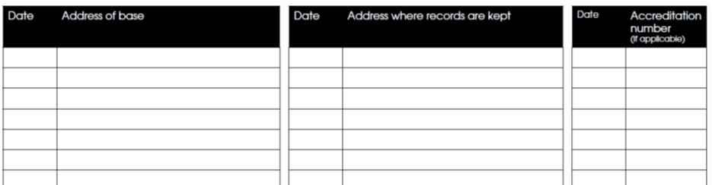
DRIVER BASE
Don't forget to fill in the Driver Base page!
Drivers must record the company BFM number here
You are required to enter both the driver base details and where the duplicate pages are kept – even if they are the same address.
WHAT IS YOUR DRIVER BASE?
The driver base is the place from which you normally work.
If you have two or more employers you may have a different base for each employer - Record each location.
If the vehicle is registered in another state, record as the base the place from which you Normally work and receive instructions when operating the vehicle.
This information must be kept up to date.

Slide 12
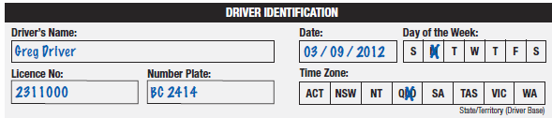

FILLING IN YOUR WORK DIARY
Driver Identification must include:
Your full name
Your driver licence
Date and day of the week
Time zone
Number plate of vehicle – change of number plate if changing vehicle must be entered into the comments section.
  WORK AND REST OPTION
  You must show which Option you are working under

Slide 13



FILLING IN YOUR WORK DIARY
To Record you work hours draw a straight line across the daily sheet in the My work bar to match the hours of work
To Record you rest hours draw a straight line across the daily sheet in the My work bar to match the hours of rest
Draw a vertical line at the time you change between work/rest or rest/work
Remember to use only black or blue pen

Slide 14
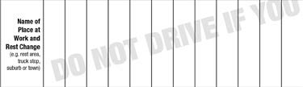

FILLING IN YOUR WORK DIARY
THE PLACE: Write the name of your work and rest change
Tottenham
ODOMETER: Record the Odometer reading at the time of you work and rest change
518,206
TWO UP: If your doing two-up, you must draw a straight line through the two-up row for all the time you are working or resting while in the two-up arrangement.

Slide 15



FILLING IN YOUR WORK DIARY
VEHICLE / NUMBER PLATE CHANGE: If you change vehicles during the day, you must write the new vehicle’s number plate and the time you changed in the comments line. Instead of writing the time you can write the new vehicle’s number plate above the time of the change in the comments line.
2 pm XS02IG
TOTAL REST AND SIGN
Just before finishing work for the day, or the first time you use your diary on the following work day, you must sign and record the total work and rest hours on the daily sheet.
Samrat Singh
10
14

Slide 16
CARRYING A WORK DIARY
CARRYING A WORK DIARY: Driver must carry a work diary if a driver:
  is engaged in 100+ km work; or
  was engaged in 100+ km work in the last 28 days; or
  is driving under BFM or AFM hours; or
  was driving under BFM or AFM hours in the last 28 days.
RULES: You must not:
record information in a work diary that you know, or ought to know, is false or misleading
Record information for the same period in more than one work diary
Deface or change a work record you know, or ought to know, is correct
Pretend you have made a work diary record or made any entry in a work diary record when this is not the case
Make an entry in someone else’s work record (unless two up)
Destroy a work record before the end of the period for which it is required to be kept
Abbreviations are acceptable provided it is likely to be understood by a person reviewing the work diary (eg Nationally recognised abbreviations WA, SA, Vic etc)

Slide 17
RECORDING TIME
TIME IS COUNTED IN 15 MINUTE BLOCKS
NHVL requires that all periods of time must be counted in 15-minute blocks.
WORK TIME IS ROUNDED UP
Work time limits are maximum limits, so work time is always rounded up to the next 15-minute interval. For example:
  40 minutes work is counted as 45 minutes of work time.
  Two hours and 21 minutes work is counted as two hours and 30 minutes of work time.
  2 minutes work is counted as 15 minutes
REST TIME IS ROUNDED DOWN
Rest time limits are minimum limits, so rest time is always rounded down to the next 15-minute interval. Eg:
  12 minutes rest does not count as rest time.
  40 minutes rest is counted as 30 minutes.

Slide 18
FALSE OR MISLEADING ENTRIES
A driver must keep an accurate work record in their possession. Severe penalties apply to drivers who:
Record information in a work diary that they know, or ought to know, is false or misleading.
Have more than one written work diary (other than a filled-up work diary).
Record information for the same period in more than one work diary.
Deface or change a work record they know, or ought to know, is correct.
Pretend they have made a work record or made an entry in a work record when this is not the case.
Make an entry in someone else’s work record (unless otherwise permitted, e.g. a police officer
making an annotation or a two-up driver’s countersignature).
Destroy a work record before the end of the period for which they are required to be kept – 3 years

Slide 19
MISTAKES
CORRECTING AN ENTRY
A driver may correct an entry in a work diary daily sheet by drawing a single line through the incorrect entry and entering the correct information. Putting a single line
through the incorrect entry is intended to ensure that an authorised officer can see the original (incorrect) entry.
The crossing out of the incorrect entry and the new information should be initialled and dated by the driver.
If corrections result in the work diary daily sheet becoming confusing or illegible, the driver should cancel that daily sheet by putting two parallel lines across the
daily sheet and writing in the word ‘CANCELLED’.
The information which is, or should be, contained in the CANCELLED daily sheet must be written on the next daily sheet. The cancelled daily sheet and the new daily
sheet must be initialled and dated by the driver.
The cancelled daily sheet and the new daily sheet must both be provided to the record keeper.

Slide 20
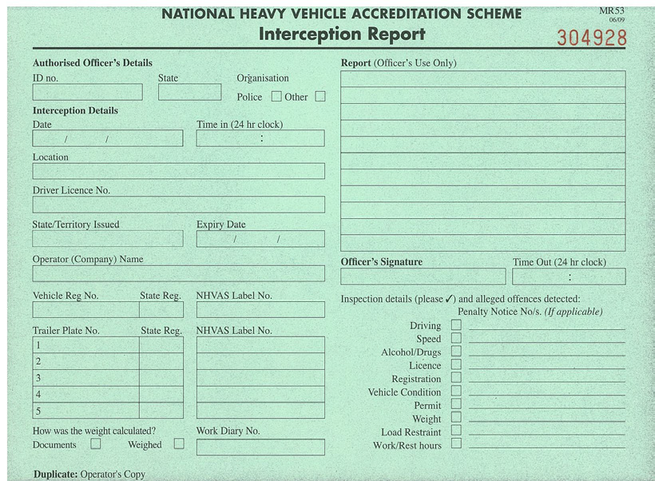
INTERCEPTED BY ENFORCEMENT PERSONNEL
WHAT SHOULD YOU DO WITH YOUR WORK DIARY IF YOU ARE STOPPED AT THE ROADSIDE?
If you are stopped by an authorised officer or a police officer for a roadside inspection, you must produce your work diary for inspection.
The officer may remove a duplicate of each work diary daily sheet (pink copy) from your work diary if required. You can ask the officer to make a note in your work diary if you have been stopped for more than five minutes.
REMEMBER – If you are in a vehicle which is
under accreditation, You should also present the vehicle interception book.
The enforcement personnel can choose whether to complete the record or not, but we MUST be able to present it.

Slide 21
WORK DIARY LOST, STOLEN OR DESTROYED
WHAT IF YOUR WORK DIARY IS LOST, STOLEN OR DESTROYED?
If your work diary is lost, stolen, destroyed or filled up before you can get a new work diary you must report this in writing to a road agency within two business days. You have a maximum of seven business days to get a new work diary.
Until you are issued with a new work diary, you must continue to record all work and rest time in a supplementary record. This must contain the same information as you would record in your work diary.
ODOMETER NOT WORKING - If you become aware or reasonably suspect that an odometer fitted to a vehicle is malfunctioning, you must inform the Scheduler as soon as practicable, but the law requires you to notify them within 2 business days
You must notify them via the repair request booklet which is found within each vehicle.

Slide 22
TRAIN.03 HEAVY VEHICLE DRIVER FATIGUE
AND WORK DIARY INDUCTION
STANDARD WORK AND REST HOURS

Slide 23
STANDARD WORK & REST HOURS
STANDARD WORKING HOURS
legislation requires a party in the chain of responsibility to take all reasonable steps to ensure that a person does not drive the vehicle on a road while the person is impaired by fatigue. Drivers are required to work/rest as below:
TIME | WORK | REST
In any period of ........ | A driver must not work for more than a MAXIMUM of ..... | And must have the rest of that period off work with at least a MINIMUM rest break of ......
5 ½ hours | 5 ¼ hours work time | 15 continuous minutes rest time
8 hours | 7 ½ hours work time | 30 minutes rest time in blocks of 15 continuous minutes
11 hours | 10 hours work time | 60 minutes rest time in blocks of 15 continuous minutes
24 hours | 12 hours work time | 7 continuous hours stationary rest time (1)
7 days | 72 hours work time | 24 continuous hours stationary rest time
14 days | 144 hours work time | 2 x night rest breaks (2) AND 2 night rest breaks taken on consecutive days.

Slide 24

STANDARD WORK & REST HOURS
24 HOURS
Heavy Vehicle National Law says you cannot work more than 12 hours in 24 hours – but do you know what 24 hours is?
When counting time for the 24-hour purposes, the time must not be counted from within rest time but instead must be counted forward from the end of a relevant major rest break.
This is the same whether
you are working local or long distance.
you are working Standard Hours or BFM Hours.

Slide 25
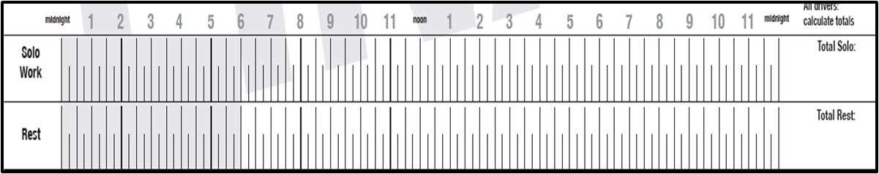
WORK & REST HOURS
WHAT DOES THIS MEAN?
This driver has worked the hours below over Monday and Tuesday on standard work and rest hours– has he breached working hours?
MONDAY
11
13
TUESDAY
5
19

Slide 26
WORK & REST HOURS
Has the driver worked more than 12 hours in 24?
The Driver has not breached as Noon to Noon in this example is NOT 24 hours
MONDAY
11
13
TUESDAY
5
19
24-hour work periods start after the end of a ‘Relevant Major Break’ and a Relevant Major Break is defined as a break of 7 hours or more
As there is only a break of 4 hours from 8 am to Noon – Enforcement personnel will not count your 24 hours from Noon

Slide 27
WORK & REST HOURS
In these examples the only start points for 24-hour periods is 7 am on Monday (after a 7-hour break) and 7 am on Tuesday (after an 8-hour break)
You may hear Drivers say they can work 15 hours in 24 hour – this is because under HVNL it may not be defined as 24 hours
MONDAY
11
13
TUESDAY
5
19

Slide 28
WORK & REST HOURS
PERIODS OF WORK TIME - LESS THAN 24 HOURS
Periods of less than 24 hours should be counted forward from the end of any period of rest time.
11
13
If we are counting that you have not worked more than 7 ½ hours in 8 (or other rule under 24 hours) we could count this period of time

Slide 29
WORK & REST HOURS
MIRROR IMAGE
We do not have to mirror image the day before under this system. Recently a driver gave me his pages to check. He thought that the enforcement personnel could count from any time at all – therefore he thought he had to Mirror Image every day – His day went something like this due to break down and being held over at loading sites.
What he did every day that week
12
12
As he thought they could count from anywhere – he thought he had to “mirror image” every day – which he did for a week!!!! He was very fatigued by the end of the week. In reality he could have gotten up the next day and done 51/4 hours straight up and bought his working hours back into some sense for the week. This would have meant he was far less fatigued by the end of the week.
What he could have done on day 2 to relieve his fatigue
12
12

Slide 30
WORK & REST HOURS
HOW DO DRIVERS GET FINED STILL?
By having a 7-hour break from 2 to 9 pm, Enforcement Personnel can now Count from 2 places on this day – so if they count from 9 pm to 9 pm he has worked 13 hours and breached Heavy vehicle national law for Standard work and rest hours.
7 ½
13 ½
12
12
It seems to be a common myth that enforcement personnel can only count from the “LAST” major break – this is not true – they can count from “ANY” major break

Slide 31
TRAIN.03 HEAVY VEHICLE DRIVER FATIGUE
AND WORK DIARY INDUCTION
BASIC FATIGUE WORK AND REST HOURS

Slide 32
BFM WORK AND REST HOURS - SOLO
TIME | WORK | REST
In any period of ........ | A driver must not work for more than a MAXIMUM of ..... | And must have the rest of that period off work with at least a MINIMUM rest break of ......
6 ¼ hours | 6 hours work time | 15 continuous rest time
9 hours | 8 ½ hours work time | 30 minutes rest time in blocks of 15 continuous minutes
12 hours | 11 hours work time | 60 minutes rest time in block of 15 continuous minutes
24 hours | 14 hours work time | 7 continuous hours stationary rest time (1)
7 days | 36 hours long/night work time (2)
14 days | 144 hours work time | 24 continuous hours stationary rest time taken after no more than 84 hours work time AND 24 continuous hours stationary rest time AND 2 x night rest breaks (3) and 2 x night rest breaks taken on consecutive days
Stationary rest time is the time a driver spends out of a regulated heavy vehicle or in an approved sleeper berth of a stationary regulated heavy vehicle.
Long/night work time is any work time in excess of 12 hours in a 24 hour period or any work time between midnight and 6 am for the equivalent hours in the time zone of the base of a driver?
Night rest breaks are 7 continuous hours stationary rest time taken between the hours of 10 pm on a day and 8 am on the next day (using the time zone of the base of the drive) or a 24 continuous hours stationary rest break.

Slide 33
BFM – SPLIT BREAK
SPLIT BREAK DEFENCE: Under BFM Drivers have a DEFENCE for taking their long break (7 hours continuous) as a split break as follows:
a 6-hour continuous rest break and a 2-hour continuous rest break within the same 24-hour period (a split rest break): as long as
The driver has not taken a split rest break in the previous 24-hour period.
Example
A driver stops work to take a 7-hour continuous rest break after 14 hours of work, but cannot sleep, so the driver takes only 2 hours continuous rest and then drives on for a further 2 hours and takes a further 6 hours continuous rest at another place down the road.
THIS IS NOT A RIGHT; IT IS A DEFENCE. Therefore, if you use this, you can be charged and appear in court for not having taken a 7-hour break in 24. It is a defence as to why you did not take the 7 hours!
You cannot use a split break in Western Australia or in the 24 hours prior to entering Western Australia.

Slide 34
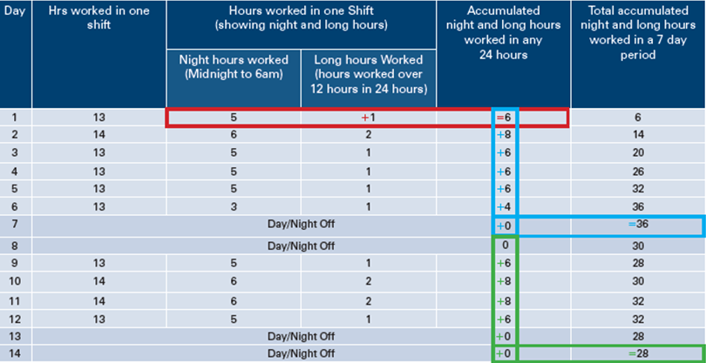
BFM – LONG & NIGHT HOURS
LONG & NIGHT HOURS
For Drivers working under BFM there are also what is known as long and night hours.
Night Hour A night hour is any hour worked between midnight and 6 am.
Long Hour A long hour is any hour worked above 12 hours in 24 hours
A driver can only work up to 36 “Long and Night” hours in any seven-day period.

Slide 35
TWO-UP – BFM WORK AND REST HOURS
MOVING FROM SOLO DRIVING TO TWO-UP DRIVING – Management requires all drivers changing from solo driving to Two-Up driving to take a 12-hour break prior to making this change.
TIME | WORK | REST
In any period of ........ | A driver must not work for more than a MAXIMUM of ..... | And must have the rest of that period off work with at least a MINIMUM rest break of ......
24 hours | 14 hours work time | No limit set
82 hours | No limit set | 10 continuous hours stationary rest time
7 days | 70 hours work time | 24 Continuous hours stationary rest time and 24 hours stationary rest time in blocks of at least 7 continuous hours of stationary rest.
14 days | 140 hours work time | 4 Night rest breaks
Stationary rest time is the time a driver spends out of a regulated heavy vehicle or in an approved sleeper berth of a stationary regulated heavy vehicle.
Night rest breaks are 7 continuous hours stationary rest time taken between the hours of 10 pm on a day and 8 am on the next day (using the time zone of the base of the drive) or a 24 continuous hours stationary rest break.

Slide 36
TRAIN.03 HEAVY VEHICLE DRIVER FATIGUE
AND WORK DIARY INDUCTION
WESTERN AUSTRALIA WORK AND REST HOURS

Slide 37
WA WORKING AND REST HOURS
Western Australia (WA) has a different system from East Coast and South Australia. In WA the driver working and resting hours are under Worksafe requirements which has a code of practice for driver fatigue.
This means that if there is a breach, Main Roads Western Australia or WA Worksafe authority will normally look at the Company systems to identify what has gone wrong rather than penalise a driver on the side of the road.
Because our drivers travel within Western Australia and within other states, we have to ensure our drivers meet the law in all states.
National Legislation tells us that when drivers are in WA for under 7 days before entering another state the driver must abide by National Legislation and WA legislation throughout the whole trip.
It is our policy drivers record working and resting hours via the National Work Diary whilst working within or into Western Australia.

Slide 38
SOLO DRIVER - WA WORK AND REST HOURS
Please Note that some of the WA legislation will show a break from DRIVING rather than work – this means the driver may do other work like fuelling in that period.
TIME | WORK | REST
In any period of .... | A driver must not …………
5 hours 20 minutes | DRIVE for more than a maximum of 5 hours | Must have a break from DRIVING of at least 20 minutes. This must include a break of at least 10 consecutive minutes during or at the end of the 5 hours.
24 hours | Have more than 17 hours between non-work periods | Must rest at least 7 continuous hours
72 hours ( 3 days) |  | Must take at least 27 hours of non-work time including 3 x at least 7 continuous hours
7 days | If there is shift work on 5 or more consecutive days, at least continuous hours of non-work time between shift changes
14 days | Work more than 168 hours
14 days / 28 days |  | Rest at least 2 x 24-hour continuous periods OR Rest at least 4 x 24-hour continuous periods in any 28 days provided hours of work do not exceed 144 hours in any 14-day period within the 28 days

Slide 39
SOLO DRIVER - WA WORK AND REST HOURS
COMPANY POLICY WHEN TRAVELLING IN WA AS A SOLO DRIVER
It is our company policy when travelling in WA that drivers will:
Not drive more than 5 hours without stopping for a break of 30 minutes including at least 2 x 15 minutes of rest time with no work undertaken (in any 5 ½ hours taken at least 30 minutes breaks from work)
Standard Hours Driver - Not work more than 12 hours in 24-hour period
Standard Hours Driver – have at least 1 x 24-hour break in 7 days
BFM Driver - Not work more than 14 hours in 24-hour period
BFM Driver - Must have 2 x 24 hour breaks in 14 days with first after no more than 84 hours work time.
All drivers must have at least 4-night breaks

Slide 40
TWO UP DRIVER - WA WORK AND REST HOURS
The daily work time for each of the two-up drivers should be shared equally
TIME | WORK | REST
In any period of .... | A driver must not …………
5 hours 20 minutes | DRIVE for more than a maximum of 5 hours | Must have a break from DRIVING of at least 20 minutes. This must include a break of at least 10 consecutive minutes during or at the end of the 5 hours.
24 hours | Have more than 17 hours between non-work periods | Must rest at least 7 hours (Note: is not required to be continuous) – can be in moving vehicle
14 Days | No more than 168 hours
Shift work | Where shift work for 5 or more days in a row | 1 x 24 continuous hours between shift changes
REST TIME NOT IN MOVING VEHICLES: Drivers are required to have rest time which is NOT taken in a moving vehicle as follows:
1 x 7 continuous hours in 48 hours OR
48 hours in any 7 days with at least 1 x 24 hours of the 48 hours being consecutive and the rest in minimum 7-hour periods.

Slide 41
REMEMBER
It is company policy all work and rest whether long distance or local, is to be recorded in your National work diary.
When entering WA all work and rest must be entered into your work diary
False or misleading records have maximum fines of up to $16,500 and 4 demerit points
All work and rest must be recorded accurately
You may only use blue or black biro within your work diary
Standard hours – local work – has all the same requirements and penalties as Long-distance travel.
Work and resting hours records may be checked randomly against GPS
Driver employment may be terminated for false/misleading records
If you have not taken an at least 15-minute break – then you have not taken any break
Any driver entering Western Australia must have successfully passed a commercial vehicle driver medical

Slide 42
COMMITMENT
Management of 5'S Australia Pty Ltd are committed to ensuring that they are compliant and that all of our people are given the knowledge to ensure they are compliant and protected
Please Complete the Questionnaire
Any concerns or Questions – please contact Management

