Slide 1

TRAIN.02 WORK HEALTH AND SAFETY
This Presentation contains a summary of Work, Health and Safety (WHS) Requirements. Full procedures are contained within your Company Manual. All Drivers should make themselves fully aware with all requirements within the manual.

Slide 2
WORK, HEALTH & SAFETY POLICY
STATEMENT OF INTENT The Health and Safety Policy of 5'S Australia Pty Ltd is to protect employees and others at our workplace from work caused injury and ill health and comply with all relevant safety legislation.
OBJECTIVES 5'S Australia Pty Ltd’s objectives in the fulfilment of their OHS policy are:
to promote a provocative approach to health and safety and encourage personnel to participate in the development of our company’s occupational health & safety programs;
to comply with the spirit and intent of all relevant legislation, Advisory Standards and Industry Standards and make adequate provision of resources to meet these requirements;
to provide adequate levels of health care and rehabilitation for all personnel;
to share occupational health and safety experience with all personnel and relevant external organisations and suppliers; and
that our contractors and third parties clearly understand and adhere to our occupational health and safety policy standards, and where necessary, assist in achieving this
to promote a provocative approach to health and safety and encourage personnel to participate in the development of our company’s occupational health & safety programs;
to comply with the spirit and intent of all relevant legislation, Advisory Standards and Industry Standards and make adequate provision of resources to meet these requirements;

Slide 3
WORK, HEALTH & SAFETY POLICY
to provide adequate levels of health care and rehabilitation for all personnel;
to share occupational health and safety experience with all personnel and relevant external organisations and suppliers; and
that our contractors and third parties clearly understand and adhere to our occupational health and safety policy standards, and where necessary, assist in achieving this
to promote a provocative approach to health and safety and encourage personnel to participate in the development of our company’s occupational health & safety programs;
to comply with the spirit and intent of all relevant legislation, Advisory Standards and Industry Standards and make adequate provision of resources to meet these requirements;
to provide adequate levels of health care and rehabilitation for all personnel;
to share occupational health and safety experience with all personnel and relevant external organisations and suppliers; and
that our contractors and third parties clearly understand and adhere to our occupational health and safety policy standards, and where necessary, assist in achieving this

Slide 4
DRUG AND ALCOHOL
DRUG AND ALCOHOL POLICY
5'S Australia Pty Ltdhas a 'zero tolerance' to drugs and alcohol within the workplace.
TERMINATION OF EMPLOYMENT If a staff member refuses to accept assistance where drug and alcohol abuse has been proved and the staff member experiences a subsequent recurrence of such abuse while working for 5'S Australia Pty Ltd, this will result in termination of employment.
If a staff member refuses to seek treatment to deal with the problem, and his or her performance has deteriorated, or if after a reasonable time following treatment there is no clear and consistent improvement in performance, the staff member will be classed as not meeting acceptable driving or employment standards and this shall result in termination of employment.
A staff member who presents for work under the influence of drugs or alcohol such that she or he is unfit for duties will be subject to disciplinary action which may result in termination of employment.

Slide 5
DRUG AND ALCOHOL
SICK LEAVE During treatment employees are entitled to normal sickness benefits if they are available.
MEDICATION / PRESCRIPTION MEDICATION If an employee’s ability to work safely may be affected as a result of medication including prescription medication, the employee should inform Management of the effects of the medication.
ZERO BLOOD ALCOHOL LIMIT All heavy vehicle drivers must have a zero-blood alcohol limit at the commencement of duty, and at all times whilst on duty. Consumption of alcohol during working hours is also prohibited for drivers and all staff members.
Staff are not to wear company uniforms to any establishment where it may be construed that they are drinking an alcoholic beverage whilst on working duties.
DRUG AND ALCOHOL TESTING To ensure this policy is effectively implemented we may conduct or ask to be conducted, alcohol and other drug screening tests in the following situations:
Pre-employment Post on the job injury Post vehicle collision
Post rehabilitation Post property damage Reasonable suspicion
At random

Slide 6
ENERGY ENHANCERS
5'S Australia Pty Ltd does not support the use or energy enhancers in any form.
Energy Enhancers can include, but are not limited to, using caffeine powder or drinks with high levels of caffeine.
There are many common misconceptions about energy drinks. many people assume they are healthy, Or at the very least they assume energy drinks are not unhealthy.
Some energy drinks on the market have over double the amount of caffeine allowed within soft drinks. Ingesting such high amounts of caffeine causes people to go into an altered state, known as caffeine intoxication. Many characteristics of caffeine intoxication are similar to the characteristics of alcohol intoxication
People experiencing caffeine intoxication experience twitching muscles, increased irritability, slurred speech, take more risks, and are easily distracted.
When a person uses energy drinks to compensate for missing a good night’s sleep it becomes far more dangerous
THE ONLY ACCEPTABLE ENERGY ENHANCER IS SLEEP!
DRIVERS FOUND TO BE USING ENERGY ENHANCERS WILL BE TREATED UNDER THE DRUG AND ALCOHOL POLICIES AND PROCEDURES

Slide 7
MENTAL HEALTH AND WELL-BEING POLICY
Management of 5'S Australia Pty Ltd are committed to the protection and promotion of the mental health and wellbeing of all staff.
5'S Australia Pty Ltd shall as far as reasonably practicable, strive to
improve the mental health environment and culture of the organisation by identifying, eliminating, or minimising all harmful processes, procedures and behaviours that may cause psychological harm or illness to its employees.
promote mental health throughout the organisation by establishing and maintaining processes that enhance mental health and wellbeing.
It is Managements policy to
Reduce discrimination and stigma by increasing awareness and understanding
provide information about the mental health policy for employees.
Provide systems that encourage predictable working hours, reasonable workloads and flexible working practices where appropriate as far as reasonably practicable.
Ensure staff have clearly defined job descriptions, objectives and responsibilities and provide them with good management support, appropriate training and adequate resources to do their job.
Manage conflict effectively and ensure the workplace is free from bullying and harassment, discrimination and racism.

Slide 8

SOCIAL MEDIA POLICY
Management of 5'S Australia Pty Ltd understands the use of social media is expanding rapidly. Individuals and organisations are embracing user-generated content, such as social networking, personal websites, discussion forums and message boards, blogs and microblogs
Whether an online activity is able to be viewed by the public or is limited to a specific group of people, 5'S Australia Pty Ltd staff must remember to maintain professional standards and be aware of the implications of their actions, as in all professional circumstances.
Staff needs to be aware that information
circulated on social media may end up
in the public domain, and remain there,
irrespective of the intent at the time of
posting.

Slide 9
SOCIAL MEDIA POLICY
In relation to social media including Facebook, blogs etc. staff:
Are not permitted to use social media during hours of duty
Must not comment on the activities of 5'S Australia Pty Ltd to their customers
Must Avoid any statements which might bring 5'S Australia Pty Ltd or their customers into disrepute
Must Not commit 5'S Australia Pty Ltdto any action or initiative
Must Not disclose or make reference to any load/manifest being carried by your or any other driver
Must Not disclose or make reference to your location or the location of other drivers
Must Not discuss or disclose any aspect of your personal terms of employment with 5'S Australia Pty Ltd such as pay rates, entitlements or any other aspect of your contract.

Slide 10
BULLYING & HARASSMENT
MOTOR VEHICLE POLICY
5'S Australia Pty Ltdis committed to provision of a fair, healthy and safe workplace in which everyone is treated with dignity and respect and in which no individual feels bullied, threatened or intimidated.
Bullying or harassment in any form is unacceptable behaviour and will not be permitted or condoned.
Definitions of what is or is Not Bullying and harassment are found within your employee manual.
Company vehicles must only be used for authorised business Subject to the restrictions stipulated within this manual. Arrangements for private domestic or social use must have been agreed in advance by Management. They may not be used for the carriage of items or passengers for hire or reward, nor may they be used for any type of motoring sport, including racing, rallying or pace making, whether on the public road or on private land.
On periods of leave, you may be required to return vehicles to the Company, unless otherwise agreed with management.

Slide 11
PRIVACY POLICY
The operation of the Privacy Act does not apply to the company in regard to any acts which directly relate to:
the employment relationship between the Employer and the individual; and
an employee record held by the Employer.
5'S Australia Pty Ltd treats the handling of your personal information very seriously. Accordingly, the purpose of this policy is to ensure the protection of your privacy in relation to the handling of your personal information
In regard to the above objective, every employee is responsible for the appropriate handling of such information and to prevent unlawful disclosure.
The fully policy is available within the Employee Manual

Slide 12

ACCIDENT AND INCIDENT REPORTING
All incidents must be reported to Management as soon as possible. These include near misses, incidents with or without injury.
ALL incidents must be reported to Management. These include:
Any injuries
Any incident resulting in property damage
Any near miss
Any vehicle accident
Any traffic law violation
Unsafe Hazards should also be reported. If you feel you are in an unsafe situation at any time, STOP and contact Management.

Slide 13
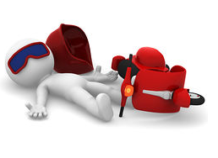
VEHICLE ACCIDENT
Should you be involved in any accident, the following procedures must be followed:
Stop immediately, do not drive away
Activate your emergency hazard lights and warning systems
Check self for injuries.
Secure your vehicle and ensure that the accident scene is safe for other traffic.
Remove debris etc only if safe to do so
Ensure that the risk of fire, further injury or damage is minimised.
If emergency service is required, dial 000 give number injured and exact location.
Advise Police. Police must be notified of any accident in which people are injured or if the owners of any damaged property cannot be located.
Advise Scheduler and obtain instructions for transportation of the damaged unit if required

Slide 14

DISCIPLINARY PROCESS
Where allegations exist concerning an Employee’s conduct or performance or with reference to vehicle accidents, incidents, breaches of legislation or company policies and procedures etc
Management, or a person nominated by Management, shall conduct an investigation to determine what circumstances should be taken into account to determine whether counselling or disciplinary actions should be taken.
Employees shall be given a fair opportunity to be heard as part of the investigation process. If requested by the Employee; they will be given the opportunity to have a witness (from within the company) present at the meetings. The witness can be at the choice of the employee, within reason.
The disciplinary systems include but is not limited to:
Opportunities for discussion about incidents
Verbal and written warnings
Termination of employment

Slide 15

EMPLOYMENT CONDITIONS
PROBATION PERIOD
All new employees will be offered probationary employment for a period up to three (3) months, at which time their employment will be reviewed. During this period, party for any reason without recrimination may terminate employment.
ABANDONMENT OF EMPLOYMENT
If you fail to attend work without notifying 5'S Australia Pty Ltd of the reasons for your absence and expected duration of the absence, 5'S Australia Pty Ltd may treat your absence as a resignation, in which case your employment with 5'S Australia Pty Ltd is terminated without notice.
5'S Australia Pty Ltd may dismiss a staff member at any time by giving to the staff member one week’s notice in writing or paying the driver one week’s salary in lieu of notice.

Slide 16
EMPLOYMENT CONDITIONS
TERMINATION OF EMPLOYMENT
5'S Australia Pty Ltd may terminate employment immediately without payment in lieu of notice if the Employee:
Commits any serious or persistent breach of any of the provisions of this Manual.
Is found guilty of any grave misconduct or wilful or reckless neglect in the discharge of his duties.
Becomes bankrupt or makes an arrangement of composition with his creditors.
Becomes of unsound mind.
Is convicted of any criminal offence other than an offence, which, in the reasonable opinion of 5'S Australia Pty Ltd, does not affect his position or his ability to perform the service.
Becomes permanently incapacitated because of accident or illness preventing them from performing the services required.
The Employee Manual includes a Listing of Breaches which may result in termination of employment.
ANNUAL LEAVE
Annual leave will be granted each year as per your entitlement and Terms and Conditions of Employment. Annual leave must be taken NOT converted into cash. Full time and part time employees get 4 weeks of annual leave based on their ordinary hours of work.
Leave application forms are available from the main office and must be lodged a minimum of 4 weeks prior to the requested commencement date of leave
Other leave entitlements are outlined within your Employee Manual or the award.

Slide 17
SUN PROTECTION
During the day you may spend time working outdoors, often when ultraviolet radiation or “UV” is at its peak. Skin cancer is primarily caused by sunlight exposure and sunburn. While both indoor and outdoor workers can suffer overexposure to the sun, outdoor workers have a much higher risk of developing the disease given the nature of their work. To reduce the risk of UV exposure and sun damage 5'S Australia Pty Ltdencourages the use of:
Sunscreen lotions
Clothing and equipment like sunglasses and,
Hats, preferably wide brimmed
SITE /DEPOT PARKING
5'S Australia Pty Ltd provides facilities for the parking of employee cars in each depot. Please use the designated area as advised by your Scheduler or Manager.
5'S Australia Pty Ltd does not take responsibility for any damage or theft from vehicles.
PERSONAL CHANGES
If you make any changes in your personal life, please consider if 5'S Australia Pty Ltd may need to know. These changes may include:
Changes of living or postal address,
Next of Kin Changes,
Emergency contact details
Banking details for wages etc

Slide 18
SMOKING
In accordance with community health standards Non-Smoking areas at 5'S Australia Pty Ltd locations are defined and must be adhered to.
Smoking is forbidden within buildings, offices and shared company vehicles. This rule applies to all 5'S Australia Pty Ltd employees, sub-contractors and visitors to sites.
Staff are to abide by all Customer Smoking rules and restrictions.
These rules also relate to e-cigarettes or forms of e-cigarettes
Drivers should NOT smoke on farm or loading and unloading sites.
OTHER PERSONS TRUCKS
If you wish to operate your own or someone else's truck, you must notify the Scheduler as this will affect your work and rest hours.
CONFIDENTIALITY
Company business is confidential, and employees are not to discuss company business with any person. Failure to comply with this condition may lead to dismissal after an appropriate investigation.

Slide 19

PERSONAL PROTECTIVE EQUIPMENT
Personal Protective Equipment (PPE) including Protective clothing and safety footwear, must be available to each employee and must be correctly worn and used at work as a matter of safety. It is expected that this uniform is clean in appearance and is regularly washed.
The following minimum PPE is required to be retained by each heavy vehicle driver:
Hi Visibility Clothing
Safety Boots or shoes
Hard Hat may be required
Other PPE may be required for particular work including Hearing protection, gloves or eye protection. If other PPE is required Supervisors will make driver aware.

Slide 20
DRESS AND PERSONAL APPEARANCE
Personal appearance and dress is a matter of common sense and personal taste. Important guidelines in determining the appropriate dress and appearance are:
The work being done
The public with whom you are dealing
General standards of neatness, tidiness, cleanliness and safety.
Thongs are banned from all worksites
Employees must be neatly presented at all times. Where uniforms have been issued they are to be worn whilst at the work site or whilst operating a heavy vehicle.
Suitable safety shoes or boots are to be worn at all times whilst working on or around any vehicle, or whilst performing any loading or unloading duties.
Specific site or customer requirements may require the wearing of additional personal protective equipment (e.g. safety vests, overalls, hard hats, safety glasses etc.)
Employees are not to wear company uniforms to any establishment where it may be construed that they are drinking an alcoholic beverage whilst on duty.

Slide 21
WHISTLE-BLOWERS
If you believe 5'S Australia Pty Ltd or any of its officers and employee is involved in any form of wrongdoing such as:
committing a criminal offence
failing to comply with a legal obligation
endangering the health and safety of an individual
environmental damage; or
concealing any information relating to the above.
You should in the first instance, report your concerns to Management who will treat the matter with complete confidence.
If you are not satisfied with the explanation or reason given to you, you should raise the matter with the appropriate organisation or body, e.g. the police, the Environment Protection Agency or Work Cover.
You will not suffer any detriment as a result of any genuine attempt to bring to light matters of concern. However, if this procedure has not been invoked in good faith (eg for malicious reasons or in pursuit of a personal grudge), then you may be subject to disciplinary action up to and including termination.

Slide 22
SAFETY RULES
CHILDREN / VISITORS
Children or Visitor visiting any 5'S Australia Pty Ltd work site must at all time remain in the care of a parent or guardian. Children cannot visit work sites without prior arrangement via Management.
PRIVATE USE OF COMPANY EQUIPMENT / VEHICLES
5'S Australia Pty Ltd’s equipment or vehicles must not be used for private purposes unless management gives express permission. Vehicles must not be taken home unless authorised by Management.
PETS
Pets are not to be bought on site or to customer sites. If for any reason a person would like to bring a pet on site or travel with a pet in a company vehicle, approval must be sought from Management.
THEFT
Any act of theft from 5'S Australia Pty Ltd or any customer will be reported to the appropriate law enforcement authority for action.

Slide 23

MEDICAL FITNESS
DRIVER MEDICALS
It is 5'S Australia Pty Ltd policy that Heavy Vehicle Drivers are required to have regular medical checks to ensure they are fit and capable to carry out their tasks with ease.
All heavy vehicle drivers are to undergo pre-employment medicals with follow up consultations as follows
Drivers aged 50 and over – annually
Drivers under 50 years of age – every 3 years
Or as per Doctor’s requirements if a lesser time is recommended
OTHER EMPLOYEES
Other employees may also be required to undertake a medical to ensure they are medically fit to undertake their duties.

Slide 24
FITNESS FOR DUTY
Each staff member must report for work physically fit in order to perform the job properly.
In the event of illness or undue fatigue, a heavy vehicle driver will not be permitted to work. Ample notice must be given to Management to permit arrangements for a substitute driver.
Punctuality is regarded as extremely important. Lateness seriously effects operations. Staff who continually report for work late will be counselled in accordance with the Disciplinary process.
Each driver is expected to report for work promptly at the time and location designated by 5'S Australia Pty Ltd. If a driver is late or expects to be late, they are to contact their Scheduler.
Drivers must assess their fitness against the Driver Fit to Work checklist found within the Company Manual and document that check has been completed on the Trip Sheet.
If you are not fit to work or become unfit throughout the work-day contact Management asap. Do Not operate a heavy vehicle if unfit to do so.

Slide 25
VEHICLE BRAKING
Drivers are required to brake with care. The vehicle will react differently according to such things as the weight of the load, the weight distribution of the load and the road surface etc.
Do not attempt to drive with low air pressure in the system.
Report all air leaks.
Report any oil in the air tanks (drain daily).
Report any uncomfortable “feel” in the brake pedal.
Report any slow pressure build up.
Always try the brakes before driving away and never drive with faulty brakes.
BRAKING DISTANCES the majority of incidents occur during braking or as a direct result of over-speed in a given situation. Keep your vehicle under control at all times. It is important that the following key points are observed

Slide 26
VEHICLE BRAKING
BRAKING DISTANCE Aim high in your view, allow yourself to have plenty of vision into the distance, should this vision be compromised, adjust your speed accordingly. Allow adequate distance between you and the vehicle in front of you so that you can stop safely if required. This is generally a three to four second gap pending conditions, dry /wet etc.
When stopping, slow gradually so that other motorists cannot mistake your intentions. Early signalling is the key to this method.
Avoid braking mid corner as this can unbalance the trailer or cause load shift. Remove the speed and brake prior to the curve and drive through the radius with your foot on the accelerator. This will increase vehicle stability and help maintain road speed.

Slide 27
IN-CAB COMPUTERS / GPS
Vehicles are fitted with / or may be fitted with, in-cabin monitoring (device) computers. Any in-cabin monitoring systems must be kept in good clean working order.
These systems are sensitive and must be treated with care at all times.
Any misuse or tampering of these devices may result in formal warnings in accordance with Company disciplinary process.
TAILGATING
This unacceptable behaviour is engaged in by only a small minority of drivers, but it has serious safety implications for all other road users. The behaviour of a few reflects poorly on the large majority of drivers who obey the road rules and take road safety very seriously.
The Road Rules requires that except when travelling on a multi-lane road or in a built-up area, a long vehicle (7.5 metres or longer) must maintain a minimum distance of 60 metres behind another long vehicle.
In a gazetted road train area, the minimum distance of separation is 200 metres. There is also a general duty to travel at a safe distance behind another vehicle.
The minimum distance requirements do not apply when overtaking the vehicle in front.
SEATBELTS
Seat Belts are to be worn at all times when using company vehicles. This is a requirement of the road and safety legislation.
ADJUSTING BRAKES- HEAVY VEHICLES
Do not adjust the brakes yourself unless you have been trained and authorised by Management to do so.

Slide 28
SAFETY RULES
PASSENGERS
Passengers are not to be carried within company vehicles unless indemnity form completed, and Management has approved.
Management may require an indemnity form to be completed.
VEHICLE CLEANLINESS/SAFETY
Cleanliness is a safety concern:
Window, mirrors and headlamps must be kept clean
The interior of the cabin must also be kept clean and free from clutter.
Do not travel with unsecured objects in the cabin.
HITCHHIKERS IN COMPANY VEHICLES
Hitchhikers are not to be carried in any company vehicle at any time. Any driver who fails to comply with this regulation will be dismissed.
SECURITY
When parking and leaving vehicles, even for short times, the Driver MUST lock the vehicle and ensure keys are taken with the driver.
Vehicles are NEVER to be left in the vehicle when the vehicle is unattended.
UNAUTHORISED DRIVERS
No unauthorised driver is to be permitted to operate a company vehicle. An authorised driver is one who is employed by 5'S Australia Pty Ltd, or another person specifically authorised by management. Dismissal will occur (after appropriate investigation), if this rule is disobeyed.

Slide 29
TAMPERING WITH EQUIPMENT
Unauthorised adjustment of, or tampering with equipment, including on-board computers, fuel pumps, speed limiters, telephones etc. and any equipment mounted on the vehicle, will not be tolerated and is grounds for instant dismissal.
Any abuse or misuse of company property is considered gross/wilful misconduct and will result in disciplinary action and is cause for dismissal.
The unauthorised fitment of any device, instrument, radio, painting, changing light lenses other than standard, or tampering with, altering or causing to be altered any setting of the vehicle, will not be tolerated and may lead to dismissal after an appropriate investigation has been conducted.

Slide 30

MOBILE TELEPHONES
The laws make it clear that a driver in a moving or stationary vehicle (unless parked) MUST NOT HOLD a phone in his or her hand.
Many of the same laws apply to the use of “Smart Watches”
Mobile Phones or Personal Listening Devices (including Smart Watches) may not be used
whilst loading, unloading , operating a ramp or any other equipment, or
whilst moving through the Depot area or
Whilst coupling vehicles, or
At any time when it is unsafe to do so

Slide 31
MOBILE TELEPHONES
MOBILE TELEPHONES INCLUDING SMART WATCHES
Any use of social media is not permitted whilst performing your daily duties under working hours.
Drivers may use the phone for; audio functions, making or receiving calls provided:
The phone is secured in a commercially designed holder fixed to the vehicle.
Attached as the manufacturer intended.
The phone can be operated by the driver without touching or manipulating the phone.
The definition of touching includes telephones resting on laps or otherwise touching the driver.
Using a phone as a navigational device is also prohibited unless:
The phone is secured in a commercially designed holder affixed to the vehicle, designed for the purpose and Attached as the manufacturer intended.
The phone and holder does not obstruct a driver’s view.
Video calls, emailing, texting, online chatting and reading preview messages are illegal activities while driving. All other uses of mobile phones not mentioned are also prohibited.

Slide 32
DAILY VEHICLE INSPECTION
FAULT REPORTING
All faults identified or repairs requested must be recorded on the Trip sheet/Repair Request Form.
Urgent Repairs – Urgent or safety related faults must be telephoned to Management ASAP. If a driver believes the vehicle is unsafe or un-roadworthy, they must not operate the vehicle.
Minor Repairs – any other repairs required, or repairs carried out by drivers, must be recorded via the daily Runsheet.
Every driver is responsible for the completion of a daily vehicle inspection on every day the vehicle is used. This inspection is to cover both the hauling unit and any trailing equipment and is to be completed prior to commencing the workday.
The Daily Vehicle Inspection must be documented via the trip sheet.
The Daily Vehicle Inspection includes an inspection of the crates for protrusions or damage with may injure livestock.
This system includes where drivers request replacement or repairs to tyres.
The checklist used for the daily check is found at the rear of the Employee Manual. All vehicles must be included on the check and each registration number must be recorded clearly on the Trip sheet.
Drivers must not operate a heavy vehicle which they believe is unsafe or unroadworthy.

Slide 33
DRIVER LICENCE
It is a nationwide law that you must hold a current and valid driving licence for the vehicle that you operate, issued in the state of domicile.
Employees who operate company owned vehicles are to supply driving records from the licensing authority when requested by management. Should you lose points or your licence, for any reason, you must advise management immediately.
Failure to advise management is considered gross/wilful misconduct and may lead to dismissal after an appropriate investigation has been completed.
Our insurance company advised us that in the event of an accident where the driver is unlicensed, and 5'S Australia Pty Ltd has no knowledge of this, they will take recovery action against the driver.

Slide 34


3-POINT CONTACT
VEHICLE ACCESS AND EGRESS / THREE POINTS OF CONTACT
Falling while getting into or out of trucks or when mounting or dismounting truck bodies or trailers can cause serious injuries. Many knee, ankle and back injuries result from jumping from equipment onto uneven ground or objects.
The biggest cause of falls from a vehicle is human error and failure to follow the “Three Point Rule”. To minimise the risks associated with getting into and out of trucks and on and off vehicles it is this Company’s policy that drivers will not:
Jump down from the vehicle at any time.
Modify or bypass any safety equipment.
Swing into or out of the vehicle when hanging by one arm.
Carry items while climbing into or out of the vehicle.
Drivers are required to:
Maintain three points of contact when getting into and out
of vehicles.
Face the vehicle when getting on or off.
Utilise access steps where provided.
Wear appropriate footwear.

Slide 35
TRAIN.02 WORK HEALTH AND SAFETY
VEHICLE BREAKDOWN

Slide 36
WARNING TRIANGLES
USE OF WARNING TRIANGLES
On a road with a speed limit of under 80km/h and the vehicle is not visible for 200 metres in all directions, three warning triangles must be placed on the road:
One triangle must be placed 50-150 metres behind the vehicle or fallen load.
One triangle must be placed 50-150 metres in front of the vehicle or fallen load.
One triangle must be placed by the side of the vehicle or fallen load.
On a one-way road or divided road, three triangles are still required. However, instead of placing the triangle in front of the vehicle, this triangle should be placed between the vehicle or fallen load, and the triangle behind the vehicle.
Requirements for placing Warning triangles in UNDER 80 kmh zones

Slide 37
WARNING TRIANGLES
USE OF WARNING TRIANGLES
If a driver of a heavy vehicle (with a GVM greater than 12t) stops or has a fallen load on a road with a speed limit of 80 kmh or more and the vehicle is not visible for 300 metres in all directions, three warning triangles must be placed on the road:
One triangle must be placed 200-250 metres behind the vehicle or fallen load.
One triangle must be placed 200-250 metres in front of the vehicle or fallen load.
One triangle must be placed by the side of the vehicle or fallen load.
Requirements for placing Warning triangles at 80 kmh or more zone

Slide 38
BREAKDOWN PROCEDURES
When a break down occurs, the driver in charge of the vehicle is to carry out the following procedures:
Move the vehicle, if safe to do so, as far as practical off the road, activate the hazard lights and place the Safety Triangles out in accordance with this manual.
Determine to the best of their ability, the nature of the break down, taking no longer than 15 minutes.
A driver may try to rectify the problem but for not longer than an extra 15 minutes.
If the problem can be rectified by the driver within 15 minutes, then they must advise Management.
Under no circumstances, without company permission, must any driver arrange with a local repairer to repair or tow a truck or trailer.
Ensure brakes engaged prior to exiting the cab
SAFETY
The single greatest risk to the driver is being struck by a passing vehicle.
Visibility is important in all conditions.

Slide 39
BREAKDOWN PROCEDURES
BREAKDOWN LOCATION
Ideally the parking location should allow 3 metres of clearance from passing traffic. If 3 metres clearance is not possible, try stopping in a location where approaching vehicles are visible, and the vehicle does not encroach onto the roadway.
Consider the suitability
Of the parking location
Does the location impede passing traffic
Is there a more suitable location?
Assess the location to determine whether the vehicle repairs can continue safely at that location.
If a clearance cannot be achieved and other measures to minimise the risk are not effective, options to carry out work safely may include:
Calling the Police or local State Roads Agency to provide traffic control.
Having the vehicle towed to safe work area before repairs are attempted.

Slide 40
BREAKDOWN PROCEDURES
VEHICLE POSITION
The truck driver must be clear of passing traffic. Consideration needs to be given to the surroundings. If the truck needs to be worked on the following factors should be considered:
If the issue is on the left side, does proximity to crash barriers or other fixtures allow enough room to work on the truck?
If the issue on the front or right-hand side of the truck, consider parking as close to the curb as possible whilst turning the front of the vehicle to the left. This will allow additional clearance
Whenever Possible, avoid parking next to a running lane.

Slide 41
BREAKDOWN PROCEDURES
VEHICLE POSITION
Turning the front away from the traffic creates a clearance. This allows the driver to exit safely
EXITING THE TRUCK
It is advisable to exit the truck cabin from the left side door. Storing the emergency triangles and portable warning lights on the left side storage compartment will also reduce the driver’s exposure to passing traffic.
Ensure brakes are engaged prior to exiting cab.

Slide 42
BREAKDOWN PROCEDURES
WARNING OTHER ROAD USERS
The truck must be seen by passing motorists. When a truck does breaks down, the following actions should be considered:
Hazard lights should be activated immediately.
Placement of Emergency Warning Triangles behind the vehicle
Advance warning should be appropriately spaced and not encroach into the running lane

Slide 43
BREAKDOWN PROCEDURES
WARNING OTHER ROAD USERS
Triangles should be placed in accordance with the Company Manual
Traffic approaching from behind can’t see the truck
due to the bridge and curve in the road

Slide 44
BREAKDOWN PROCEDURES
WARNING OTHER ROAD USERS
Triangles give advance warning to other drivers that there is a hazard ahead
VEHICLE STABILITY
Avoid the truck collapsing or load falling. Tyre fitting should take place on hard, flat and even surface that is able to withstand load (including the point load of a jack or axle stand).
Consider the surface at the location. For example, has recent rain softened the ground? Full or partial unloading of the truck could be considered to increase stability in some circumstances.

Slide 45
BREAKDOWN PROCEDURES
EMERGENCY ROADSIDE REPAIRS
A 45-degree angle increases visibility for passing traffic. In this position, the mechanic is protected from passing traffic and can safely access both sides of the service vehicle.
AFTER THE BREAKDOWN
Debris created by the breakdown can be a danger to other road users. Prior to leaving the site, any parts such as tyre tread or broken fenders should be cleared if it is safe to do so.
VEHICLE RECOVERY
Please consult with Management by phone prior to any vehicle action being taken.

Slide 46
TRAIN.02 WORK HEALTH AND SAFETY
COUPLING AND UNCOUPLING TRAILERS

Slide 47
COUPLING TRAILERS
Causing a trailer to be dropped due to not completing the Coupling or Uncoupling Procedure fully is classified as Serious misconduct. Serious Misconduct is defined within the Company Driver Manual and a 1st Offence may result in termination of employment.
COUPLING
Before coupling the prime mover to the trailer, you should Get Out and Look:
Check the trailer skid plate, kingpin, turntable and jaws for damage
Check the skid plate, kingpin, turntable and jaws for damage
Make sure the jaws are open
Make sure the top of turntable is well greased or Teflon plate is not damaged on fixed turntables
For trailers without a block the turntable will need to be in the locked position if possible or lower the air bags until the turntable is under the skid plate
Visually inspect the trailer for protruding hazards which may cause injury
REVERSE THE PRIME MOVER INTO POSITION
Reverse the prime mover into position straight in front of the trailer using mirrors to line up position of the trailer.
Stop short of the turntable going under trailer.
Once in position apply vehicle park brake exit the cab & check the jaws are in open position
Lower Airbags.
Check that the turntable and kingpin are lined up.
If the trailer is equipped with maxi brakes (spring brakes), the trailer brakes should be already on. If not, chocks should be used.

Slide 48
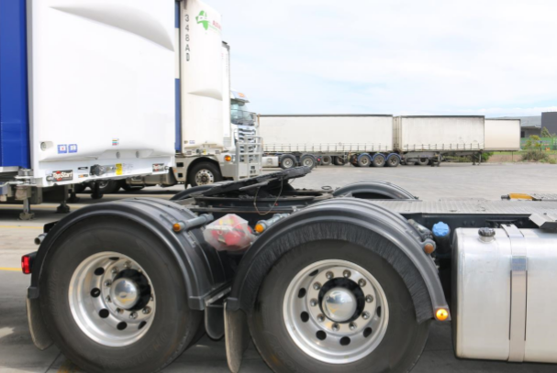
COUPLING TRAILERS
CHECK HEIGHT
Check that the height of the trailer skid plate is slightly lower than the center of the turntable. About 50 mm (5 cm) is ideal.
If the trailer is too low, the prime mover chassis and turntable can hit the trailer front and cause damage. (Air lines, electrical connections).
If the trailer is too high, the jaws may rap around the bottom flange of the kingpin, causing damage or will separate (prime mover and trailer). The turntable may even pass beneath the king pin, allowing the prime mover cab or rear lights and guards to hit the trailer.
IF the turntable locking pins cannot be engaged (ball race) due to the profile of the turntable, dump the air bags.

Slide 49
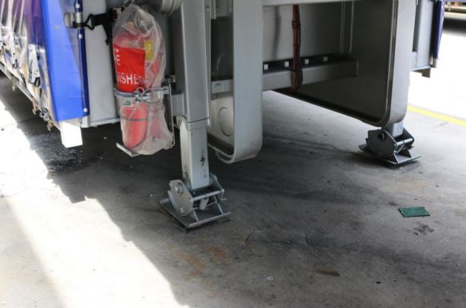
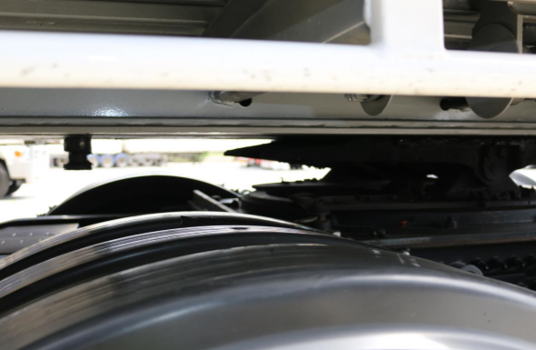
COUPLING TRAILERS
REVERSE THE PRIME MOVER INTO POSITION
Select low reverse, then slowly reverse the prime mover until the turn table is under the skid plate. (to the front mudguards then stop)
If necessary, raise the air bags to ride height until the legs are clear of the ground.
Exit the Cab.
Visually check:
the landing legs are clear of the Ground
there is no air gap between the skid plate and the turntable.
Raise Airbags.
Resume slow reverse under the
trailer until the turntable jaws lock around the
kingpin. A loud clicking sound can be Heard.

Slide 50
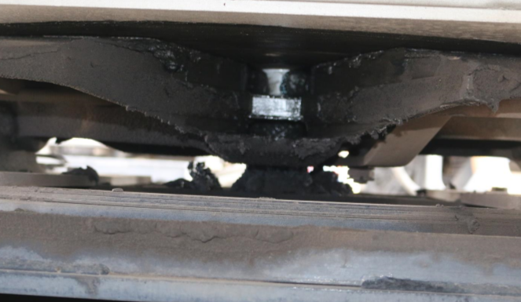
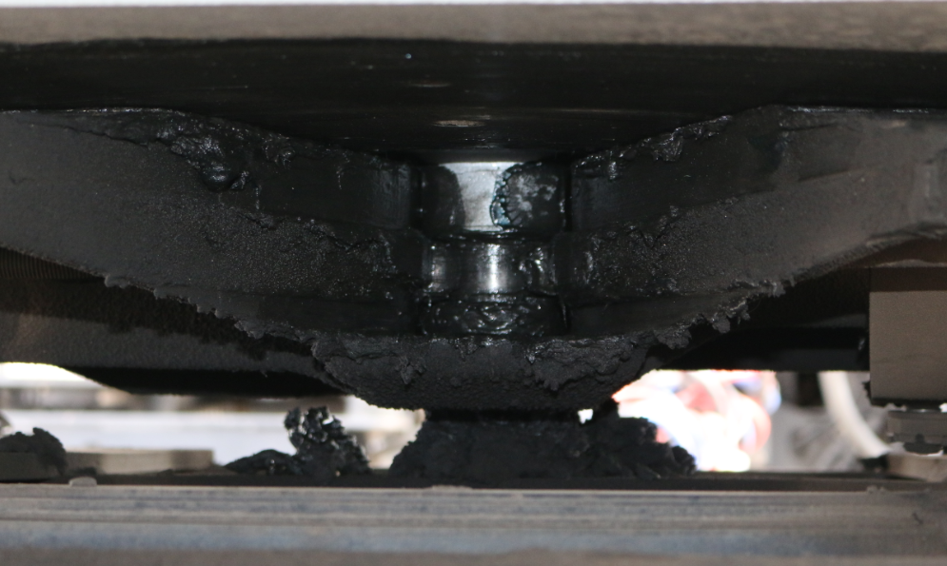
COUPLING TRAILERS
TUG TEST
Check the trailer is locked on by taking up the clutch to the friction point, in first gear (tug test). The prime mover should not move.
Apply the park brake and put vehicle gearbox in neutral.
Turntable secured
GET OUT AND CHECK
Get Out and visually check that the back of the turntable and the turntable jaws have locked on to the kingpin.
Watch not to hit your head on the underside of the trailer and ensure the slide bar on the turntable is closed (across the back of the trailer pin)
Turntable NOT secured

Slide 51
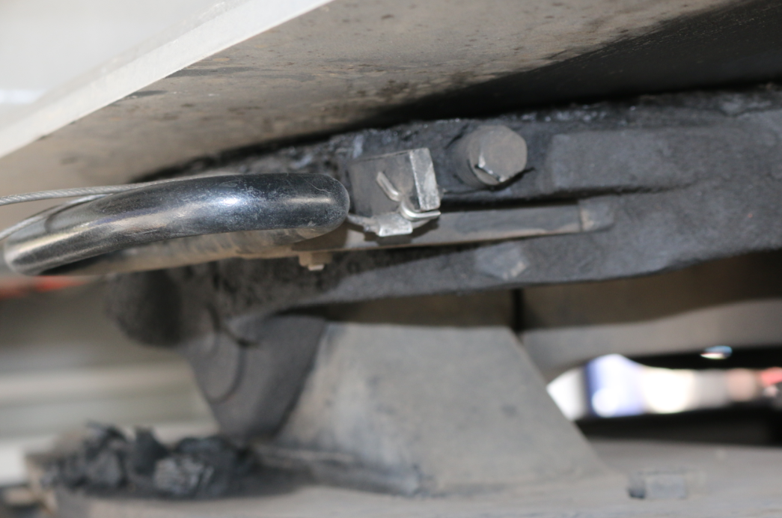
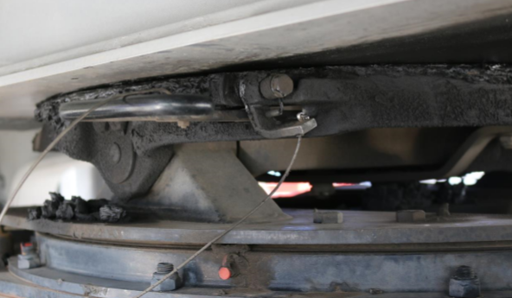
COUPLING TRAILERS
GET OUT AND CHECK
Make sure the head (bottom flange) of the
pin is not sitting on top of jaws.
The trailer should be sitting firmly on the turntable by checking there is no gap between the turntable and the trailer skid plate. If gap is showing and the landing legs are raised, uncouple and recommence the process. If coupling has occurred without the use of the air bags, raise the landing legs and recheck the gap.
Check that the coupling release lever is in the locked position. Some levers require a manual lock tab, this must be used to prevent the lever opening while towing. If the locking tab or the safety chain cannot be fitted, the turntable is not locked.
You may need to use a torch or light source
Safety latch not down. Do Not Move
Safety latch down Safe to Travel

Slide 52
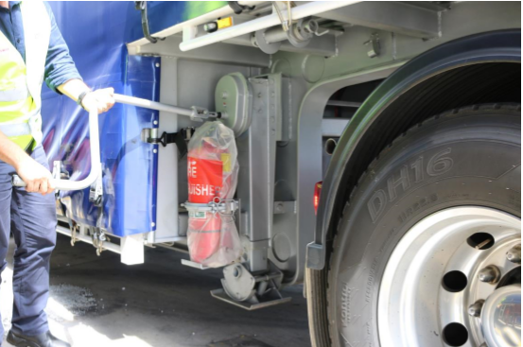
COUPLING TRAILERS
Raise the landing gear. Engage winding handle on legs and wind legs to the up position.
RAISE LANDING GEAR
Keep winding until fully raised.
Leave the landing gear engaged.
Make sure the handle is properly stowed, or damage can occur. If using a trailer for the first time, check the clearance movement between the prime mover (frame and wheel guards) and the trailer. Check also that there is enough clearance between the landing gear and the back of the truck frame to allow for turning.

Slide 53
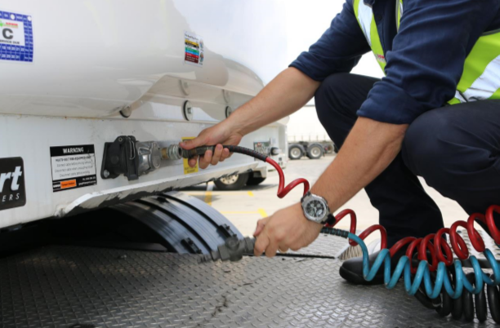
COUPLING TRAILERS
TEST LIGHTS
Return to the vehicle and enter the cab to apply park light and hazard lights.
Exit vehicle to inspect all lights are working correctly.
Return to prime mover.
CONNECT AIR HOSES AND ELECTRICAL CABLES
Carefully climb on the rear of the vehicle and connect all air hoses and electrical lines to trailer. (Connect - Air lines, electrical leads, EBS and ABS leads)
When connecting air lines ensure the connection tabs are locked on the joiners (1/4 turn). If fitted, the shut-off valves are turned on to supply air and charge to the trailer. With prime movers with the air supply valve on the interior dash it is advisable to activate supply while the trailer check is done as this will charge the air systems on the trailer (brakes and air suspension).
Remove and stow wheel chocks when used.

Slide 54
COUPLING TRAILERS
TUG TEST
Reset the air bag level.
Before moving off, do a SECOND tug test by applying the trailer brakes and again taking up the friction point in first gear. This is to confirm your trailer is securely hitched and the trailer brakes are serviceable.
FINALLY
As you move forward at low speed (5kph) and in a straight line, do a 3rd Tug Test by slowly applying pressure to the trailer brake hand piece.
This confirms that the trailer is securely hitched, and the supply and service pressure to the trailer brakes have reached operating levels, and the trailer should dip slightly to confirm that the brakes are adjusted correctly.

Slide 55
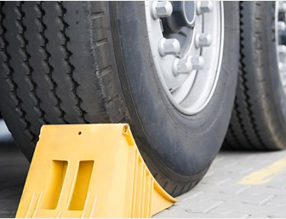
UNCOUPLING TRAILERS
BEFORE UNCOUPLING
Maneuver vehicle into a suitable position to be uncoupled (ie ensure ground is solid)
Make sure your combination is parked on a level surface which is firm enough to support the trailer landing gear and its load
Make sure the prime mover and semi-trailer are in a straight line
Apply the maxi brakes (parking brake) on prime mover
Chock the trailer wheels if required.
Exit Prime Mover
USE CHOCKS
Always use chocks where rear loading trailer is performed off a dock and if it is necessary to park on a grade. It is best to chock the semi-trailer’s front axle in case the landing legs collapse and the rear axle(s) lift.

Slide 56
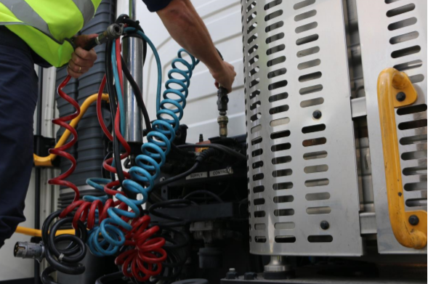
UNCOUPLING TRAILERS
AIR HOSES
Disconnect the air hoses and electrical cables from the trailer. Stow them properly on the prime mover making sure that the connectors are kept free of water and dust, and they cannot get caught on the tailshaft. Make sure air supply taps are turned off (if fitted).
LOWER LANDING GEARS
Engage trailer legs wind handle.
Lower the landing gear until the supports are in contact with the ground and airbags can be heard releasing air pressure.
Ensure visual check is conducted to make sure both legs have been lowered.

Slide 57
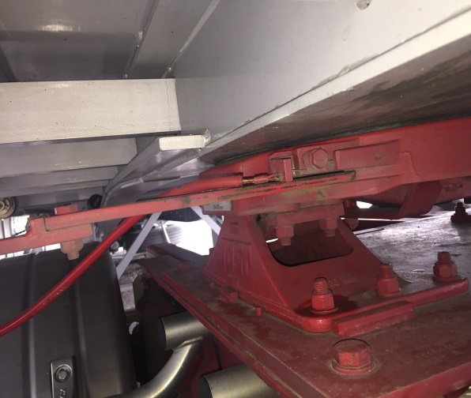
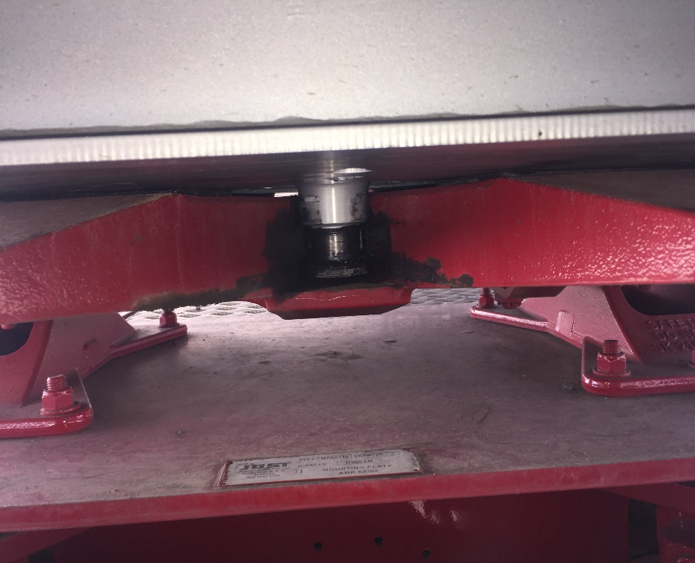
UNCOUPLING TRAILERS
RELEASE TURNTABLE JAWS
NOTE: release handle lock tab raised (open position) & slide bar not covering trailer pin
Pull turntable release handle.
Raise the lock tab or undo the lock pin before releasing the jaws. If the release handle cannot be moved, the jaws may be under load. Take the pressure off by rocking the prime mover forward and back and then try to release again.

Slide 58
UNCOUPLING TRAILERS
DRIVE FORWARD
AIR BAG
Check landing legs are secure & not sinking into ground.
Return to the prime mover and slowly move forward after releasing the park brake until trailer is halfway over front of mudguards then stop.
Ensure vehicle in straight line.
Apply vehicle brake and lower airbags.
Make sure the trailer stays put.
Air bag suspension prime movers. Ensure the airbags are down prior to completely clearing the trailer. If they are still fully inflated damage may occur to the mud guards and the trailer.
After the prime mover has completely cleared the trailer, reset the airbags, or dump valve.

Slide 59
TRAIN.02 WORK HEALTH AND SAFETY
TRANSPORT EMERGENCY RESPONSE PLAN

Slide 60
EMERGENCY RESPONSE PLAN
5'S Australia Pty Ltd has a full Transport Emergency Response Plan. This plan outlines policies and procedures around emergencies.
Examples of what may be an emergency include but is not limited to:
Motor Vehicle Incident | Severe Storm (including Cyclone, floods)
Mobile Plant Failure/Incident | On Road Security Incident
Injury/Multiple Injury/Illness | Theft or Hijacking of Vehicle
Fire / Smoke, Bushfire | Vehicle Fire
Chemical Spill | Electrical Failure / Electric Shock
Bomb Threat | Explosion
Armed or Dangerous Intruder/Civil Disturbance | Armed Person Attempting to Enter or Already in Cabin
Full procedures are within the Employee Manual and identify appropriate telephone numbers and responsible persons

Slide 61
IMMEDIATE RESPONSE
IMMEDIATE RESPONSE ON SITE
If an employee perceives a threat or incident which is likely to affect their safety or safety of others they shall:
Assist any persons in immediate danger if safe to do so
Contact their immediate Supervisor or a member of the Emergency Response Team
Contact emergency services if required and clearly identify the following information:
Who is calling
Location of the emergency
Brief summary of the emergency
Type of assistance required
IMMEDIATE RESPONSE OFF SITE
If an employee perceives a threat or incident which is likely to affect their safety or safety of others they shall:
Assist any persons in immediate danger if safe to do so
Contact emergency services if required and clearly identify the following information:
Who is calling
Location of the emergency
Brief summary of the emergency
Type of assistance required
Contact their immediate Supervisor or a member of the Emergency Response Team

Slide 62
EMPLOYEE RESPONSIBILITIES
If an employee is involved in an incident, they must immediately report to Police on 000, and in addition initiate internal contact to their immediate Supervisor – the order of which is dependent upon the incident.
remain with the person, vehicle or equipment if safe to do so, and if able
Take direction from Supervisor and/or Emergency Response Team
Assist local emergency services until relieved by other 5'S Australia Pty Ltd personnel
Under the direction of 5'S Australia Pty Ltd Emergency Response Team member, assist with clean-up actions at the site such as removing dangerous goods, repackaging and packing for further transport.
Create exclusion zone around incident scene (if possible)
Once incident is under control, complete 5'S Australia Pty Ltd incident report and co-operate with any investigations.

Slide 63
MEDIA
The press will often be present at an emergency. A designated media contact will serve to assist in relaying important information between the organisation and the media.
Employees are not to speak to media in any circumstances and must refer all media requests to the Transport Emergency Response Team.
The below general statement to be used as a guide by the Senior Management or appointed Media Response
Representative only:
“At (insert time and date) an incident involving our premises/vehicle occurred at …
It appears that the incident occurred during loading/unloading procedures. OR.
We are unable to ascertain at this moment the cause of the incident.
Our personnel who have been trained to handle such emergencies have implemented our emergency response procedures without delay.
Our Company Director will be happy to respond to your questions further after the matter has been thoroughly investigated.”

Slide 64
MOTOR VEHICLE ACCIDENT
If vehicle is in contact with power source, stay clear and advise occupants to stay in the vehicle and not to touch any metallic parts
Contain leaking fluids using sand, dirt, or fire extinguisher if safe to do so
Take note and record the following information (if possible and where applicable):
Other vehicle and driver details – registration number, name, telephone etc
Other driver licence number and insurance details where possible
Location and time of incident
Witness details/names/address
Road and weather conditions
Emergency services on site
Do not admit liability to any person
Do not make any comment to the media
Ensure photos of the accident are
Where the driver of the vehicle is uninjured and able to the driver should:
Keep calm, think clearly
Assist persons who may be injured if possible or safe to do so - Do not attempt to remove persons from vehicles unless they are in immediate danger
Contact 000 for Emergency, Police or Fire Brigade if required
Warn traffic from all directions with triangles (if applicable)
Notify everyone in the immediate area to stay clear of the scene (if possible)
Switch off vehicle ignition, if safe to do so
Contact Company Supervisor
If vehicle is on fire use portable fire extinguisher if safe to do so
Assess vehicle and site damage, and take necessary actions to secure and isolate scene

Slide 65
FIRE OR SMOKE
The safety of the personnel is of the utmost important.
Where there is a fire or suspicion of fire:
Evacuate the area if your safety is in danger and make your way to the nearest designated assembly location.
Ensure the immediate safety of anyone in the vicinity of the fire or smoke, if safe to do so
Contact Supervisors and evacuate anyone in the vicinity of the fire
Assist any persons who require help, if safe to do so
Contain the fire by closing doors (do not lock) and isolating the fire
Attack base of fire to extinguish using available firefighting equipment, if safe to do so
BUSHFIRE
Before Fire arrives at the site the First Responder or First person to become aware of the bushfire should:
Inform the Supervisors or Site Manager of the situation
Evacuate the area if your safety is in danger and make your way to the nearest internal evacuation assembly area.

Slide 66
SITE INTRUSION
The safety of personnel on site is of the utmost priority if an intruder is found to have entered a company depot.
If a person is found to have intruded onto an 5'S Australia Pty Ltd Site and If you are a person directly involved with an armed or dangerous intruder, you should:
Be deliberate in your actions
Be reasonably slow (consider your safety) in handing over keys, money or information
Follow instructions of the intruder
If possible, move the situation away from other workers
Observe the offender (height, weight, age, clothing, speech disabilities, accent, etc.)
Do not provoke or confront the intruder
If you are the first able person you should:
Warn others
Restrict access to workers and visitors
Do not approach intruder or crowds
Evacuate quietly
Notify Police of the intrusion
Notify the Emergency Response Team in order of priority

Slide 67
BOMB THREAT
WRITTEN BOMB THREAT
Where a written threat is received the following systems should be followed:
The person who receives the written threat must:
Keep all paper and envelopes for evidence purposes
Notify Supervisor
Avoid unnecessary handling of the object / letter
Do no photocopy as this may deteriorate fingerprints or other evidence
Seal letter and envelope in a plastic bag or larger envelope
VERBAL BOMB THREAT
Where a verbal threat is received the following systems should be followed:
The person who receives the written threat must:
Never ignore a threat
Do not hang up the telephone
Attract someone’s attention and obtain assistance to notify the Emergency Response Team in order of priority
Do not create panic in the office, remain calm and only notify those that must be involved
Attempt to keep caller talking
Document all information available
Remain at telephone until relieved

Slide 68
AUTHORITY TO STOP - Management and drivers have a shared responsibility to ensure vehicles are operated safely. Drivers have absolute authority to stop without prejudice, when they believe they are unable to continue driving safely.
Please Complete the Questionnaire
Any concerns or Questions – please contact Management

