Slide 1

TRAIN.01 CHAIN OF RESPONSIBILITY

Slide 2
POLICY
Management of 5’s Australia Pty Ltd understands under Heavy Vehicle National Law (HNNL) and Western Australia Road Traffic Legislation the only defence to a Chain of Responsibility (CoR) breach is if you took ‘all reasonably practicable steps’ to prevent the occurrence of the breach.
It is Managements policy that 5'S Australia Pty Ltd will take all reasonably practicable steps including having systems in place to manage, reduce or where possible eliminate a potential contravention.
Complying with HVNL and CoR Responsibilities is a Core Value of 5'S Australia Pty Ltd. Management are committed to adhering to the standards imposed by the HVNL and .
To assist in meeting our responsibilities, 5'S Australia Pty Ltd are committed to:
Consulting with drivers and others within the chain
Maintaining work systems to enable compliance with National and Western Australian Legislation
Ensuring Management exercise relevant supervision and control over 5'S Australia Pty Ltd systems
Addressing and monitoring breaches or concerns raised
Provide CoR Awareness training
Provide the resources to achieve this commitment

Slide 3
POLICY
OBJECTIVE It is 5'S Australia Pty Ltd objective to take all reasonably practicable steps to ensure breaches of the following do not occur:
Heavy Vehicle Mass
Heavy Vehicle Load Restraint
Vehicle Dimensions
Driver Fatigue and Working/Resting hour’s legislation
Heavy Vehicle Speed
Heavy Vehicle Maintenance
Safety
ACCREDITATION AND COMPLIANCE 5'S Australia Pty Ltd is committed to best practice in relation to CoR and as such follows the standards and guidelines set down by the following:
National Heavy Vehicle Accreditation Standards
Western Australian Heavy Vehicle Accreditation Standards
Registered industry Code of Practice – Master Code

Slide 4
WHO DOES IT EFFECT?
The legislation nominates people involved in a logistical task. If you are involved in any of the following activities, you may be held responsible for breaches of road laws:
Consignor – a person or company who arranges transport of goods
Packing – placing goods in packages, containers or pallets
Loading/ Loading Manager – placing or restraining the load
Driving – the physical act of driving a heavy vehicle (>4.5 t GVM)
Operating – operating a business which controls the use of a heavy vehicle
Scheduler – a person who schedules transport of passengers or goods by road
Consignee / Receiver – paying for the goods/taking possession of the load
Employer - A person who engages someone else to drive a heavy vehicle
Workshop Personnel
Safety and Auditing Personnel
CONSIGNOR
PACKERS LOADERS
LOADING MANAGERS
OPERATORS OF HEAVY VEHICLES
SCHEDULERS
CONSIGNEES – RECEIVERS OF GOODS
WORKSHOP PERSONNEL
SAFETY AND AUDITING PERSONNEL
EMPLOYERS OPERATORS OF HEAVY VEHICLES

Slide 5
DRIVER RESPONSIBILITIES
As a driver your responsibilities include making sure that you:
comply with relevant fatigue management work and rest laws and procedures to implement them
make sure you make the most of your rest breaks by sleeping in dark, quiet and comfortable places
respond to changes in circumstances (such as delays) and report these to your base (if possible) to implement short-term fatigue management measures
ensure your vehicle does not exceed mass or dimension limits
Not exceed posted speed limits
Not travel at an unsafe speed given the conditions
Monitor and report on vehicle defects or repairs required to vehicles
Not to operate an unroadworthy or unsafe vehicle
ensure your load is appropriately restrained
Not exceed applicable Mass limits
Deliberately underload if in doubt of true weight
SCHEDULER RESPONSIBILITIES
Scheduler responsibilities include making sure:
Rosters and schedules do not require drivers to exceed driving hours regulations or speed limits
you keep records of your drivers’ activities, including work and rest times
you take all reasonably practicable steps to ensure drivers do not work while impaired by fatigue or drive in breach of their work or rest options
vehicles are regularly maintained, and if speed limiters are fitted they are functioning properly
vehicles are not loaded in a way which exceeds mass or dimension limits
drivers moving freight containers have a valid Container Weight Declaration

Slide 6

WORKSHOP RESPONSIBILITIES
ENFORCEMENT POWERS
Workshop personnel responsibilities include making sure that you:
Records of maintenance carried out are available in an auditable and legible manner for a minimum of 3 years
Records of preventative maintenance are made which each service carried out
Repairs are prioritised and completed within a reasonable timeframe
Where repairs are not completed, or parts are on order, or the repair is being monitored etc – full details are the person making the decision to continue to operate the vehicle is documented
Records of Workshop personnel training or competency is available
you take all reasonably practicable steps to ensure all vehicle maintenance is carried out in a competent manner.
Speed limiters are checked regularly to ensure they are functioning
Any concerns with vehicle maintenance is raised with Management
Search, seize and inspect powers support the enforcement of the chain of responsibility. These laws allow authorized officers and police officers to:
Inspect and search heavy vehicles and premises associated with road transport
Direct a person associated with road transport to provide documentation and items relating to heavy vehicle compliance
Require a driver or other responsible person to provide reasonable assistance to an inspector or police officer and to state the person’s name, home address and business address
Require a person to provide details
regarding any other person who is
associated with a heavy vehicle or its load,
and to give information to help identify
the driver

Slide 7
CHAIN OF RESPONSIBILITY -PENALTIES
APPROXIMATE PENALTIES INCLUDE:
Breaches (or Fines) are categorised as:
Minor – Maximum Fine $5,300 at court or $530 on roadside
Substantial – Maximum Fine $8,000 in court or $800 on roadside
Severe – Maximum Fine approx. $13,310 court / $1331 on roadside & 3 demerit points
Under Fatigue management there is an additional category –
Critical risk – Maximum fine approx. $20,000 and 4 demerit points. (must go to court)
Category | Description | Individual | Corporation
3 | Breaches Safety Duty | $66,532 | $665,320
2 | Risk of Death / Injury | $199,917 | $1,999,170
1 | Recklessness | $98,776 5 years imprisonment | $3,987,760
Penalties as of 1 July 2024

Slide 8
MANAGEMENT AND COMPANY
MANAGEMENT AND COMPANY RESPONSIBILITIES
The legal duties apply both inside and outside a road transport company. Within a company, any person with control over road transport operations could be held personally responsible and be subject to large fines just like those for drivers
We also have obligations not to coerce, induce or encourage a breach of road transport laws. In addition to ensuring compliance with road laws, you have to take reasonably practicable steps to make sure that you do not pass on to other parties any false or misleading information about a vehicle or its load.
There are a range of Sanctions which can be placed on companies including:
Prohibition Notice – Prohibited from Operating the Business
Improvement Notices
Having outsiders appointed to Monitor work
Compensation orders
Orders to Install Monitoring devices like GPS or Electronic Work diary
Training or Supervising of Staff
Intervention orders

Slide 9
TRAIN.01 CHAIN OF RESPONSIBILITY
HEAVY VEHICLE SPEED

Slide 10
HEAVY VEHICLE SPEED
HEAVY AND LIGHT VEHICLE SPEED POLICY
5'S Australia Pty Ltd is committed to reducing the risks which our employees face and create when driving for work. We ask all our staff to play their part, whether they use a company vehicle, their own, or a hire vehicle.
Employees driving for work must never drive faster than conditions safely allow and must obey posted speed limits at all times. Exceeding the speed limit is against the law. Persistent failure to comply with the law will be regarded as a serious matter and gross speeding while driving for work will be regarded as a serious disciplinary matter.
Staff who gain penalty points on their licence may be required to take further driver training. Company vehicles may be withdrawn from staff who attain 9 or more penalty points. They will be withdrawn from staff who are disqualified from driving.
We will co-operate with police enquiries resulting from an alleged speeding offence or incident and supply details of the employee (or the driver, if different) to whom the vehicle is allocated.

Slide 11

HEAVY VEHICLE SPEED
Employees who drive for work must:
never drive faster than conditions safely allow and obey posted speed limits at all times
ensure they know what the maximum speed limit is for the vehicle they are driving. (100 kmh for heavy vehicles and 110 kmh for light vehicles)
plan journeys so they can be completed at safe speeds and without exceeding speed limits
report road safety problems, including crashes, incidents, fixed penalty notices, summons and convictions for any offence, including speeding, to their manager
present their licence, and any other documents required, for inspection on request (normally annually)
co-operate with monitoring, reporting and investigation procedures
Drivers are reminded that the Absolute Highest Speed Limit for Heavy Vehicles over 4.5 tonne is 100 kmh. Although vehicles must also be aware of and comply with all speed limits.
Speed limits include the following:
A sign posted speed limit that applies for a length of road where the driver is driving the vehicle, or
A speed limit specified by legislation the applies for a length of road where the driver is driving the vehicle, or
A speed limit that applies to a driver of a particular heavy vehicle for a length of road where the driver of the vehicle is driving the vehicle or
A prohibition on travelling between two places in less than a specified time that applies to a driver of a heavy vehicle for a length of road where the driver is driving the vehicle. (Cameras)
The Maximum Speed for Heavy Vehicles is 100 kmh

Slide 12
HEAVY VEHICLE SPEED
SPEED LIMITERS
A Prime Mover manufactured on or after 1 January 1988 having a GVM exceeding 15 tonnes must be speed limited to 100 kmh
A Prime Mover manufactured on or after 1 January 1991 having a GVM exceeding 12 tonnes must be speed limited to 100 kmh
ROAD TRAIN SPEED
Maximum Speed for Road Trains is as follows:
Victoria 100 kmh
New South Wales 90 kmh
Queensland 90 kmh
South Australia 90 kmh / 100 kmh
Western Australia 100 kmh
SOUTH AUSTRALIA
Road trains are permitted a maximum speed 100 kmh on Eyre Highway, West of Port Augusta and on the Stuart Highway, North of Port Augusta
POSTED SPEED LIMITS
Where there are lesser speed limits posted you must abide by those speed limits.
The person responsible for a vehicle which must be speed limited is guilty of an offence if the vehicle is not speed limiter compliant.
TAMPERING WITH SPEED LIMITERS
Speed Limiters must not be tampered with – if it is identified a speed limiter has been tampered with and responsible person is identified – their employment will be terminated.

Slide 13
DISCIPLINARY PROCEDURE
While driving company vehicles all employees must obey all speed limits at all times. Heavy vehicles are speed limited to 100 kmh – this is non-negotiable.
The following outlines the consequences of exceeding the speed limit in Company owned heavy or light vehicles:
EXCEEDING SPEED LIMIT UP TO 10 KMH
First Offence – verbal counselling to restate company policy
Second Offence – Written warning issued stating that two further breaches will result in termination
Third Offence – Final written warning stating the employee will be terminated if the offence is repeated
Fourth Offence – termination of employment
EXCEEDING SPEED LIMIT OF BETWEEN 11 AND 20 KMH
First Offence – final written warning stating the employee will be terminated if the offence is repeated
Second Offence – termination of employment
EXCEEDING SPEED LIMIT ABOVE 20 KMH
First Offence – termination of employment

Slide 14
TRAIN.01 CHAIN OF RESPONSIBILITY
HEAVY VEHICLE MASS

Slide 15
NHVAS MASS ACCREDITATION
There are currently 3 levels of weights a heavy vehicle can operate at. (Well sort Of!)
These are known as:
General Mass
Concessional Mass
Higher Mass
Sitting under these are also the numerous Schemes! Including:
Grain loading schemes
Livestock loading schemes
Measurement Adjustment
Floating Tonne / Floating ½ Tonne
And numerous other differences between states or schemes
We will try and run through the relevant ones for you in this presentation
FLOATING TONNE
The floating tonne is not available to Accredited Vehicles and the Floating ½ tonne is only relevant to livestock transporters or when working under the Grain Harvest Management Scheme.

Slide 16
NATIONAL HEAVY VEHICLE ACCREDITATION - MASS MANAGEMENT
The National Heavy Vehicle Accreditation (NHVAS), Program was developed by Government and Industry to allow Transport Operators to use documented and audited assurance systems to demonstrate compliance with regulations.
Accreditation to the NHVAS Mass Scheme is a prerequisite for operation of a vehicle at higher or concessional mass limits
HIGHER MASS LIMITS
Companies wanting to operate at Higher Mass Limits within NSW, must have vehicles fitted with an approved GPS system which is monitored by a 3rd party – our company will only operate at Concessional Mass Limits in NSW but Higher Mass Limits in Victoria.

Slide 17
6.5 TONNE ON THE STEER
Trucks are able to operate up to 6.5 tonnes on the steer axle if the trucks have all of the following:
An engine complying with the emission control requirements of ADR 80/01 (Euro 4 engine) or later version of ADR 80;
A front underrun protection device that complies with UN ECE Regulation No. 93
A cabin that complies with UN ECE Regulation No.29
Appropriately rated tyres, axle, and suspension, to allow 6.5 tonnes on the steer axle; and
A Gross Vehicle Mass (GVM) of 15 tonnes or more.
7.1 TONNE ON THE STEER
Prime Movers are able to operate at 7.1 tonne on steer when having Road Train registration (MC Registration) and meet the following standards:
Requirements of the 6.5 tonne steer axle, (as above) and
Prime mover fitted with tyres with a section width of at least 375mm
7.1 tonne on steer is only permitted on Road Train approved routes.

Slide 18
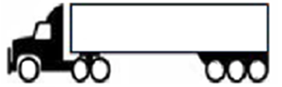
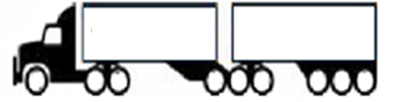
SINGLE ARTICULATED VEHICLE
Limit | Steer | Drive Axle | Tri Group | Gross Combination
GML | 6.5 t | 16.5 t | 20 t | 43 tonne
CML | 6.5 t | 17 t | 21 t | 44 tonne
HML | 6.5 t | 17 t | 22.5 t | 46 tonne
B-DOUBLE VEHICLE
Limit | Steer | Drive Axle | Tri Group | Tri Group | Gross Combination
GML | 6.5 t | 16.5 t | 20 t | 20 t | 63 tonne
CML | 6.5 t | 17 t | 21 t | 21 t | 65 tonne
HML | 6.5 t | 17 t | 22.5 t | 22.5 t | 68.5 tonne
Our Prime Movers can travel at 6.5 tonne on the steer axle groups

Slide 19
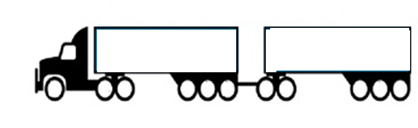

ROAD TRAIN – TANDEM AXLE DOLLY
Our Prime Movers can travel at 6.5 tonne on the steer axle groups
Limit | Steer | Drive Axle | Tri Group | Dolly | Tri Group | Gross Combination
GML | 7.1 t | 16.5 t | 20 t | 16.5 t | 20 t | 80.1 tonne
CML | 7.1 t | 17 t | 21 t | 21 t | 21 t | 82.1 tonne
HML | 7.1 t | 17 t | 22.5 t | 17 t | 22.5 t | 86.1 tonne
ROAD TRAIN – TRI AXLE DOLLY
Limit | Steer | Drive Axle | Tri Group | Dolly | Tri Group | Gross Combination
GML | 7.1 t | 16.5 t | 20 t | 20 t | 20 t | 83.6 tonne
CML | 7.1 t | 17 t | 21 t | 21 t | 21 t | 85.6 tonne
HML | 7.1 t | 17 t | 22.5 t | 22.5 t | 22.5 t | 91.6 tonne

Slide 20

NATIONAL HEAVY VEHICLE ACCREDITATION
How Do You Know if the Vehicle is on NHVAS Mass?
This Sticker will be on the side of the Prime Mover with the Mass Management Blue label and Maintenance will be identified by the Yellow strip.
Any trailers can be used on the mass program. The trailers are not registered on the mass program.
If the trailer does not have Road Friendly Suspension it must be loaded to Concessional Mass Limits only.
WHERE CAN CONCESSIONAL MASS VEHICLES TRAVEL?
No Additional route restrictions apply under CML. Operators eligible for CML may travel on all roads, except where prohibited by a load limit specified for a road, bridge or causeway by a sign or notice.

Slide 21
DRIVER RESPONSIBILITIES UNDER HEAVY VEHICLE MASS ACCREDITATION
Under our accreditation program Drivers are required to:
Complete and document in full the daily inspection of the vehicles including trailers
Recording any fault found and reporting via telephone to Management.
Participate in training and education programs provided
Completion and Documentation of the Daily Fitness to Work Check
Completion and Documentation of the Load restraint and dimension check
Completion of the Mass Management Record for all trips.
Ensuring that the following is recorded for all trips loaded above General Mass Limits:
Date of Trip
Vehicle Details – Prime Mover and Trailer Registration or Fleet Numbers
Axle Groupings – either by gauge or weighbridge
Gross Weights – if available
Loading and Unloading Sites
Driver Signature
Ensure that all route requirements are met;
Ensure the NHVAS sticker is fixed and legible – report to Management if not
Deliberately under loading if doubt exists as to the true weight of the load.
Report any problems to Management
DRIVERS MUST NOT OPERATE A HEAVY VEHICLE THEY BELIEVE IS UNROADWORTHY OR UNSAFE
DRIVERS MUST NOT OPERATE A HEAVY VEHICLE IF THEY ARE NOT FIT TO DO SO

Slide 22
TRAIN.01 CHAIN OF RESPONSIBILITY
HEAVY VEHICLE DIMENSION

Slide 23
PRESCRIBED DIMENSIONS
A general access vehicle may operate to the following dimensions:
Width: The width limit for heavy vehicles is 2.5 metres
Any anti-skid devices mounted on wheel, central type inflation systems, lights, mirrors, reflectors, signally devices or tyre pressure gauges fitted to the vehicle are to be disregarded when measuring vehicle width.
Height: The height limit for heavy vehicles is 4.3 metres unless it is a:
Vehicle built to carry cattle, horses, pigs or sheep 4.6 metres
Vehicle built with at least 2 decks for carrying vehicles – 4.6 metres
Length: The length of a vehicle for general access is 19 metres or less in combination length (or a maximum 12.5 metres for rigid vehicles)
RESTRICTED ACCESS VEHICLE
A vehicle is classified as a Restricted Access Vehicle (RAV) if that vehicle alone or together with any load, exceeds one or more of the following limits:
a width of 2.5 metres
a height of 4.3 metres
a length of 12.5 metres in the case of a motor vehicle that is not part of a combination; or
a length of 19 metres in the case of a combination
any other dimension specified in Heavy Vehicle National Law

Slide 24
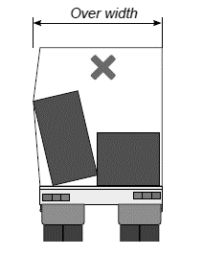
NON-CONFORMING LOADS
Vehicles with loads which do not conform with prescribed limits, permits or notices etc must have the load modified or adjusted to ensure it is within legislated limits.
Non-conforming loads may include those where curtains are bulging due to load restraint issues or any concern which results in a breach of dimension
REMEMBER – non-conforming loads could be where there is product pushing on the curtain of the trailer.

Slide 25
TRAIN.01 CHAIN OF RESPONSIBILITY
LOAD RESTRAINT

Slide 26
LOAD RESTRAINT
INTRODUCTION
Secure restraint of loads on vehicles is important in preventing accidents and injury to people or damage to property. Restraining correctly will help prevent:
The load sliding or rolling forwards into the truck cabin with serious risks to the driver.
The load falling from the vehicle onto other vehicles or pedestrians.
Drivers and riders having to swerve to avoid fallen items.
Vehicles overturning because of the load shifting while cornering or changing lanes.
Disruption to traffic flow.
WHY LOADS MOVE
The following factors can cause movement of any load that is not adequately restrained:
impacts in minor crashes:
sudden braking or accelerating;
sharp cornering;
adverse road camber;
hilly or rough road surfaces; and/or
wind and airflow over the vehicle.

Slide 27
DRIVER RESPONSIBILITIES
Drivers are responsible for:
Checking the structural integrity of the load restraint equipment as part of each daily vehicle check
Entering into the fault repair request in concise detail all faults found with the load restraint equipment
Continually check contained loads
Reporting all incidents and near misses using the incident reporting process
Ensure gates, Curtains and doors are secured prior to leaving loading site
Load in accordance with Customer recommendations and instructions where these are provided
ACCESSING THE VEHICLE TRAY
Drivers should not access the load carrying area if machinery or equipment is being used to load / unload the vehicle. Employees and pedestrians must be excluded from areas of operation which may result in an injury.
If Drivers do access the vehicle tray, they must use 3-points of contact.
LOADING / UNLOADING
During unloading:
Ensure the vehicle brakes have been applied before unloading begins.
Keep the material under control at all times and do not allow it to roll off the vehicle.
Don’t tie the load to an object to drag it off by moving the vehicle.
Ensure vehicle is on even ground.
Do not operate mobile telephones or personal listening devices (ie iPods)
UNSURE – If you are unsure of the load restraint requirements or any incident occurs, please notify your Scheduler immediately

Slide 28
LOAD RESTRAINT
EXCLUSION ZONES
Customers may require Drivers to stay within exclusion zones whilst vehicles are being loaded or unloaded. Drivers are required to abide by Customer requirements.
MOVEMENT OF THE VEHICLE AFTER STARTING UNLOADING
Should a vehicle be required to move after unloading has commenced, it will be necessary to complete an assessment of the further steps to determine if the movement can be completed safely. Before any movement of the vehicle, it is necessary to secure the remainder of the load.
DIMENSIONS
All vehicles must have loads restrained to ensure they do not compromise the dimensions of the vehicle – eg bulging curtains.
UNSAFE
If the site is unsafe to load or unload, do not load or unload and contact your Scheduler ASAP
LOAD RESTRAINT GUIDE
All loads should be restrained in accordance with the National Transport Commission, Load Restraint Guide https://www.ntc.gov.au/

Slide 29
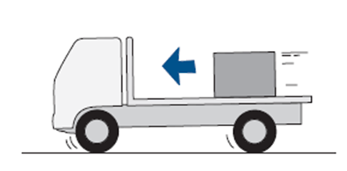
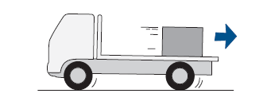
LOAD RESTRAINT
CoR and OH&S Laws requires that
Loads must be restrained to prevent unacceptable movement during all expected conditions of operation.
Loads must not be placed in a way that makes the vehicle unsafe or unstable.
Loads must be secured so that it is unlikely to fall or be dislodged from the vehicle (not just whilst in transit but also during unloading i.e. OH&S; duty to provide a safe workplace and systems of work)
When moving, a vehicle and its load are subjected to forces caused by changes of speed, direction or slope. These forces result from braking, accelerating, cornering or travelling over cambered, undulating or uneven road surfaces and air flow.
The load can shift forward when driving forward and braking, or accelerating in reverse.
The load can shift rearwards when braking in reverse or accelerating forward

Slide 30
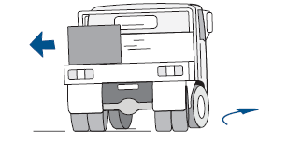
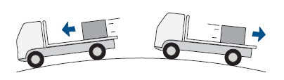
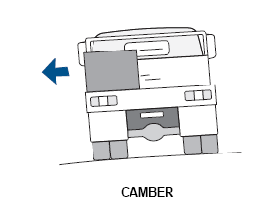
LOAD RESTRAINT
The load can shift sideways when cornering. The amount of force needed to prevent the load shifting will increase as the speed increases and as the corner gets tighter.
The force on the load when travelling over undulating or hilly roads will increase as the slope of the road increases
The force on the load when travelling over cambered roads increases as the camber of the road increases

Slide 31
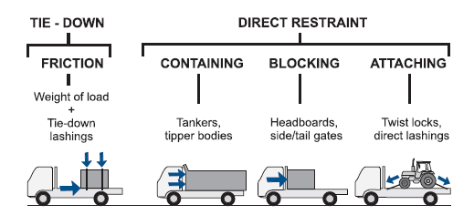
LOAD RESTRAINT
LOAD RESTRAINT METHODS
Loads can be restrained by two basic methods called “Tie-Down” and “Direct Restraint”
Tie-Down is when the load is prevented from moving by friction only
Direct Restraint is when the load is prevented from moving by containing, blocking or attaching it to the vehicle

Slide 32
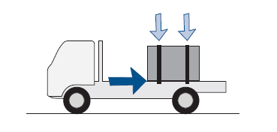
LOAD RESTRAINT
TIE DOWN METHOD
Tie-down restraint is the most common form of load restraint and involves the use of lashings.
The load is prevented from moving by friction between the load and the vehicle.
The friction force prevents the load moving forward, rearward and sideways. The lashings are tensioned to clamp the load to the vehicle and to prevent the load from moving upwards.
The friction force comes from both the weight of the load and the clamping force of the lashings. When the surfaces are slippery,
the friction forces can be very low.
Lashings that clamp the load onto
the vehicle are called ‘tie-down lashings’

Slide 33
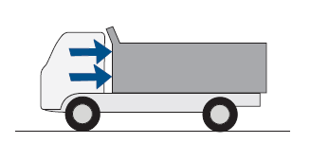
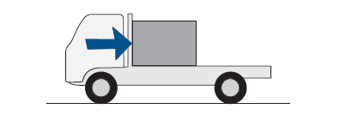
LOAD RESTRAINT
DIRECT RESTRAINT METHOD
A load can be directly restrained by containing, blocking or attaching without any assistance from friction.
Contained loads can be directly restrained without any securing devices. These include liquids in tanks, bulk solids in tanks or rigid sided bodies and mixed loads of various items in rigid sided bodies or containers.
Blocked loads can be directly restrained by blocking against vehicle structures or other items of load or packing in contact with the structures. These structures include headboards, braced loading rack, drop-sides and bulk heads. In this example the load is blocked from moving forward by the headboard but requires additional sideways, rearward and vertical restraint

Slide 34
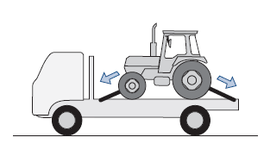
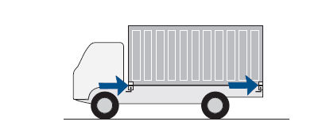
LOAD RESTRAINT
DIRECT RESTRAINT
Direct restraint by attaching can use lashings or mechanical locking devices. Attached loads can be directly restrained by lashings that provide all the necessary restraint
LOAD ATTACHED USING DIRECT LASHINGS
Attached loads can be directly restrained by mechanical locking devices that provide all the necessary restraint – this picture shows a shipping container restrained by twist locks. The twist locks do not rely on friction between the load and the deck.

Slide 35
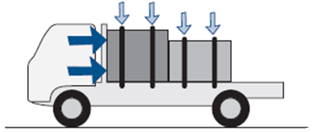
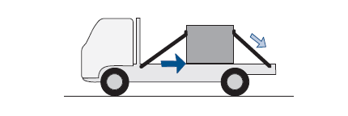
LOAD RESTRAINT
Combined tie-down and direct restraint uses both friction and direct restraint
This load shows
Friction force from the weight of the load, plus
Friction force from tie-down lashings, plus
Blocking (the front part of the load is blocked by the headboard and the rear of the load is then blocked by the front part)
The load is prevented from moving forwards by a combination of friction force from the weight of the load and the lashing tension, and also blocking against the headboard.
The load is prevented from moving
rearwards and sideways only by friction.
The load is prevented from moving
upwards by the lashings.
This picture illustrates load restraint provided by:
Friction force from the weight of the load, plus
Friction force from the downward force from the lashings, plus
Direct restraint from lashings that are attached to the load.

Slide 36
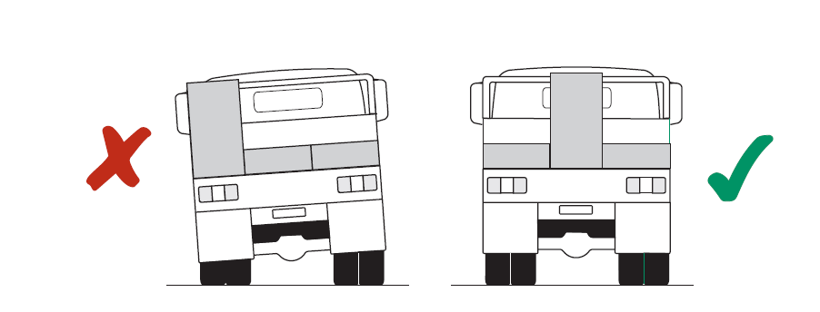
LOAD RESTRAINT
POSITIONING THE LOAD
Incorrect positioning of the load on a vehicle can result in a significant safety risk. The load must be positioned to maintain adequate stability, steering and braking, and not overload tyres and axles.
A load should be positioned so that its centre of mass is as low as possible and not offset to one side of the vehicle. Positioning the load in this way will reduce the vehicle’s tendency to overturn when cornering. This can be achieved by loading heavy objects first and placing them close to the centre-line of the vehicle.
During all expected operating conditions, which can include minor collisions, the load restraint system must ensure that:
(1) The load does not dislodge from the vehicle; and
(2) Unacceptable load movement does not occur.

Slide 37
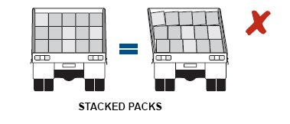
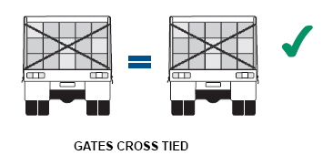
LOAD RESTRAINT
SIDE GATES
Most drop-in side gates are not capable of restraining tall or stacked loads unless they are supported at the top by diagonal cross lashings to the opposite tie rails or are attached to other structures such as bulkheads or loading racks.
When straps are tensioned over the top of opposite gates, they clamp the load together and prevent the gates lifting. If the load is stacked more than one high, the gates cannot prevent the top layers from tipping sideways
If the load is stacked and the gates are braced with diagonal lashings from the top of each gate to the tie-rail on the opposite side, the gates can restrain the load.

Slide 38
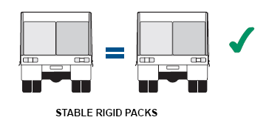
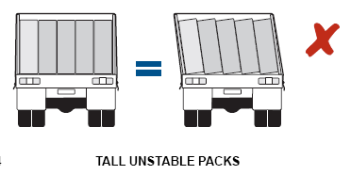
LOAD RESTRAINT
GATES CROSS TIED
If the load is a rigid and stable single layer, the gates can restrain the load
If the load is tall and unstable the gates cannot prevent the load from tipping sideways

Slide 39
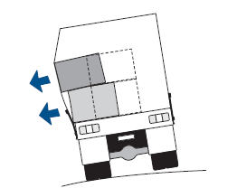
LOAD RESTRAINT
SIDE CURTAINS
Side curtains on vehicles are generally used to protect the load from rain and dust and are usually quicker, easier and safer than a tarpaulin to put in place and secure.
The curtain is a thin, flexible sheet and even when reinforced with full-height webbing strapping, it can only resist sideways load movement if it deflects or bulges outwards. However, in some cases, a load shift that occurs can make the vehicle unstable and cause an accident. The bulging, particularly when the vehicle is stationary, can also make the vehicle wider than the maximum legal width.
The bulging of a curtain causes the curtain or straps to pull down on the roof and upwards on the coaming rails. The strength and flexibility of the roof, the top track and rollers, the curtain and straps and attachments are all critical to the load restraint capacity of a curtain. They are more effective when deflected at the bottom rather than halfway up because they adopt a greater angle to more directly resist the load shift.

Slide 40
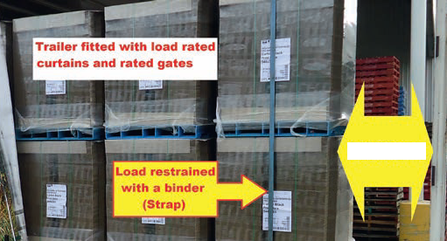
BINDERS
Blocking is the term used to describe placement of loads within trailers.
Blocking can be placing stock against the headboard, tailboard, or placing restrained ply sheeting, empty pallets, shoring bars, air bags, etc against the load to minimise load shift where a ‘Full Load’ is not achieved. Blocking must prevent the pallet or load from moving sideways, forwards or rearwards within the trailer.
All loads must utilise ‘blocking’ where a space greater than 100mm (10 cms) exists between loaded product and where a ‘Full Load’ has not or cannot be achieved against the headboard, tailboard or step deck.
Example: Trailers fitted with load
rated curtains for palletised
product or gates; if a >100mm
space (gap) exists between the
last pallets and the tailboard
then the last pallets must be
restrained using a binder over
the top of the pallets.
100 mm gap

Slide 41
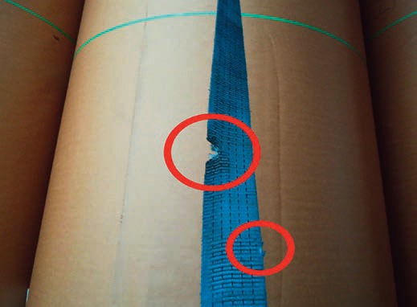
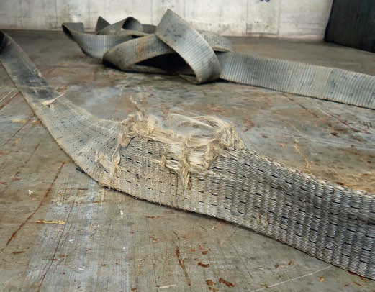
LOAD RESTRAINT
SIDE CURTAINS
A curtain-side without side gates may prove to be satisfactory as the only sideways load restraint system for a lightweight load that is fully packed inside the vehicle.
Curtains can be effective as a secondary restraint system for containing small lightweight individual items that can become separated from packaging and which would not tear/damage the curtain.
As a general principle, where the curtains are not certified for load restraint purposes, the load must be restrained as if the curtain did not exist.
✘
✘
BINDERS
Webbing straps with a ratchet handle are to be used to tighten and provide initial restraint for on loads.
No frayed or visibly damaged binders are allowed to be used to restrain loads. If your straps are damaged or frayed, please contact your Scheduler for new straps.

Slide 42
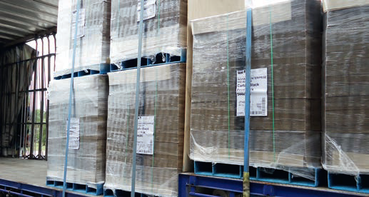
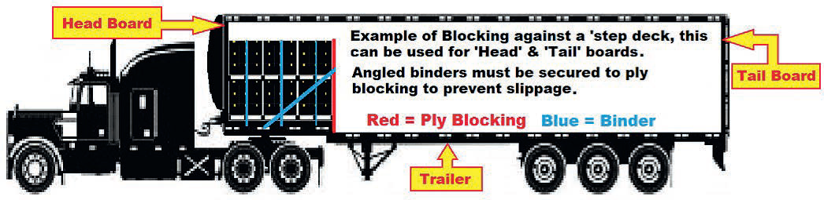
BINDERS
Pallets must be restrained if part loaded or differing heights. Below is an example of strapping pallets which are on a step deck trailer

Slide 43
TRAIN.01 CHAIN OF RESPONSIBILITY
DRIVER AND PUBLIC SAFETY

Slide 44
DRIVER AND PUBLIC SAFETY
2018 saw the introduction of Safety Duties into Chain of Responsibility Legislation. This is very much the same as Worksafe Requirements. This requirement includes Management having to:
Identify risks to driver and public safety
Assess the risk
Manage the risk to reduce the chance of a safety incident
Document and record actions taken to manage safety
This part of the legislation is mainly set at Management – asking Management about their systems. BUT employees including drivers, workshop personnel, loaders, unloaders etc do have a DUTY to report any accidents, incidents or concerns.
Example: if you are loading a vehicle and identify a concern with a bald tyres then you have a duty to report this.
Simply put There is a Duty or Obligation for all those in the chain to eliminate or minimise potential harm or loss (risk) by doing all that is reasonably practicable to ensure safety

Slide 45
TRAIN.01 CHAIN OF RESPONSIBILITY
ROLL-OVER

Slide 46
ROLL-OVER PREVENTION
CAUSES
A major study of 239 truck rollover crashes in the USA revealed that the following factors contributed to the crashes:
almost half resulted from inappropriate speed when changing direction, that is, on corners, curves, and, on and off ramps
the type of load being carried
the condition of the brakes
driver distraction, i.e. inattention, dozing or falling asleep.
Rollover crashes can involve many factors such as
vehicle speed
The load – especially where the load may move
the type of vehicle and its condition (eg brakes, suspension systems and higher centre of gravity vehicles),
The weather
The turning angle
The tyres
Location and road stability, and
the drivers knowledge and experience.

Slide 47
ROLL-OVER PREVENTION
To understand how rollover crashes occur, we need to understand the factors involved in rollover crashes, which are speed, centre of gravity, braking and centrifugal force
SPEED
The effect of speed on cornering stability, braking distance and impact forces are all made worse by increased speed. Cornering forces don’t just double when the vehicle speed doubles, they increase by four times.
CENTRE OF GRAVITY
Everything is affected by gravity and therefore has a centre of gravity: the point around which the object is balanced in all directions.
Trailers with a high centre of gravity can rollover on an incline of as little as fifteen degrees, while the prime mover which, has a lower centre of gravity, will only rollover if the incline is more than sixty degrees. The higher the centre of gravity, the more unstable the truck; the lower the centre of gravity, the more stable the truck
A Vehicle which is 4.6 metres high, has a higher centre of gravity than most vehicles and therefore is more likely to be involved in a roll-over

Slide 48
ROLL-OVER PREVENTION
BRAKING
The faster a vehicle travels, the longer it takes to stop. For example, if a truck’s speed is doubled, it will take four times longer to stop
CENTRIFUGAL FORCE
Centrifugal force is the force that makes objects slide across the seat when a vehicle corners at high speed. It happens when a moving object, such as a vehicle, changes direction.
Changing direction causes a force pushing the vehicle away from the centre of the turn which can lead to a rollover.
The tighter the turn, the greater the force will be to push the truck over. The same applies for the speed of travel to negotiate the turn.
Together, both speed and tightness of the turn will increase the risk of rollover. If a truck travels around a corner at 30km/h certain forces will apply. If the truck travels the same corner at 60km/h these forces increase by four time

Slide 49
ROLL-OVER PREVENTION
STABILITY
The faster a vehicle travels, the longer it takes to stop. For example, if a truck’s speed is doubled, it will take four times longer to stop
REDUCE THE CHANCE OF ROLL-OVER
To reduce the chance of a roll-over drivers should:
Understand the vehicle dynamics and what may cause a roll-over
Use the correct driving techniques to manage the forces at work
Ensure the vehicle speed is appropriate for driving conditions
Consider the effects of road conditions on the load
Remember your load is also a moving load which adds another level of risk
Reduce pressure on yourself – Reduce stress
Check the route before you travel
REMEMBER
Keep your cabin clean
Wear your seat belt, and
Watch your Speed

Slide 50
COMMITMENT
Management of 5'S Australia Pty Ltd are committed to ensuring that they are compliant and that all of our people are given the knowledge to ensure they are compliant and protected
Please Complete the Questionnaire
Any concerns or Questions – please contact Management

